Slide 1
Welcome to Class Selection for Seniors
Class of 2025

Slide 2
You’re about to be a Senior!

Slide 3
We have a few tasks for you today
Look at the credits you need for graduation
Select your classes for next year
Input your classes into the computer

Slide 4
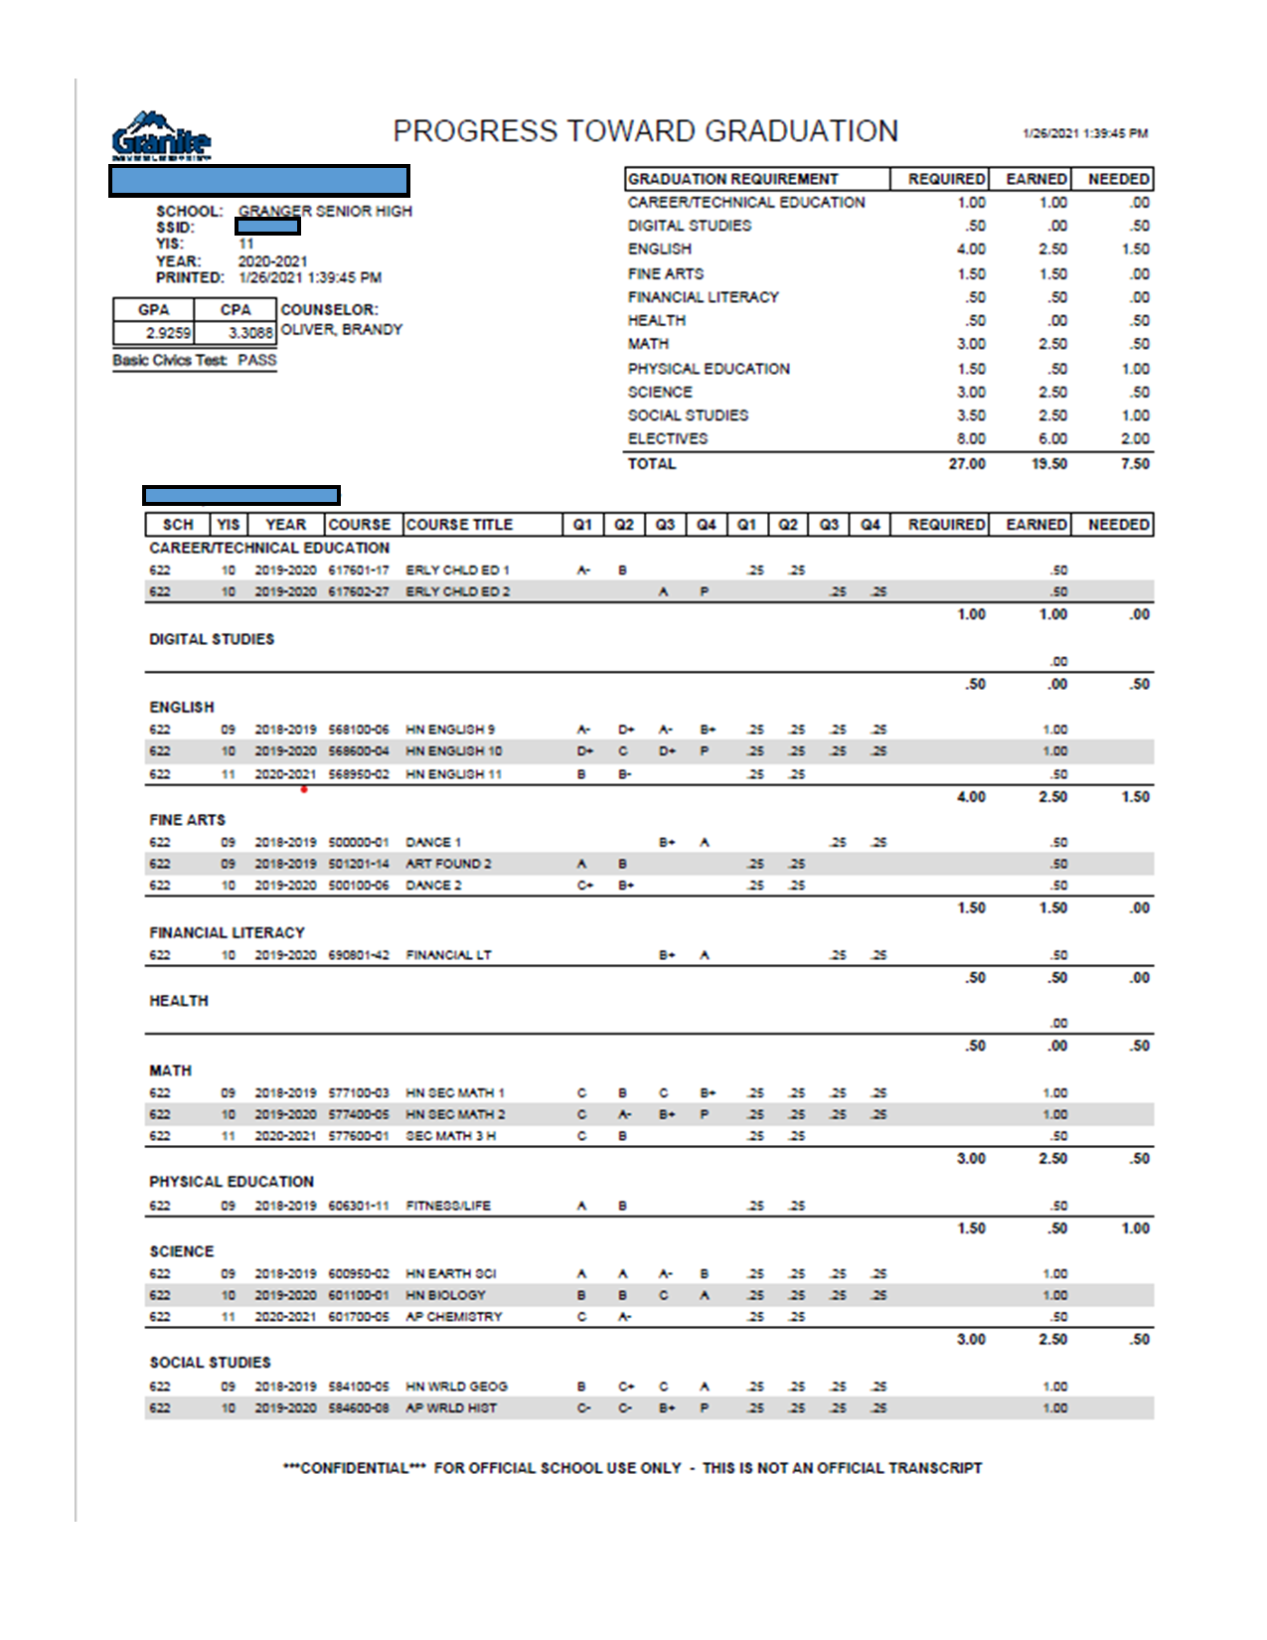
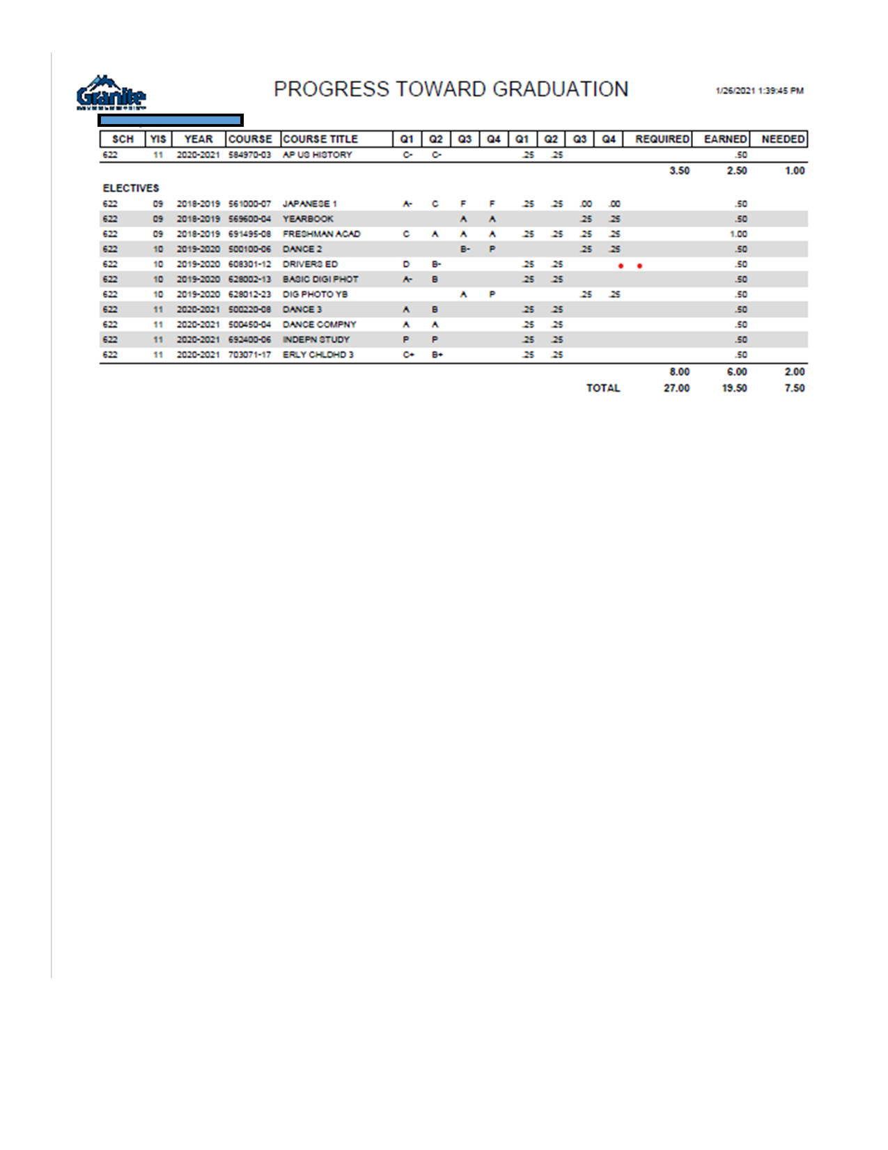
Graduation Requirements

Slide 5
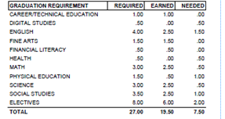
Graduation Requirments -
You should have between 15.75 credits (if you’re a seminary student) and 18 credits

Slide 6
CPA needs to be at least a 2.0 if you want to walk at graduation. GO TO CLASS!

Slide 7
You are the graduating class of 2025!
There are many things available to help you be successful this year:
You will take the ACT on March 26th. Go to grangercounselingcenter.com for test prep
You will have a College and Career Readiness Plan (CCRP) with your counselor 1st quarter of your senior year
Start thinking about where you want to apply and explore colleges and post high options. College day is Tuesday, February 6th
Utah College Application Week is in October. You will need to apply to at least one college and you will fill out your FAFSA in October
Get involved in school and look for scholarships.

Slide 8
Some things to keep in mind when choosing classes:
Choose classes that connect to your interests
* What are you interested in taking?
* What do you want to do after high school?
Connect to your abilities
* What are you good at doing?
* What skills do you want to refine?
ALL YOUR CREDITS COUNT - SO PLAN ON PASSING ALL CLASSES
DO NOT:
* Choose classes your squad wants you to take with them.
* Take classes with your boyfriend or girlfriend (because it's SUPER awkward when you break-up)
* Sign up for TA or Home Release or Sports Teams or Audition Classes (make sure you sign up for a full schedule!!!!!)

Slide 9
You can take classes to help you get ahead:
Honors - rigorous classes that prepare you for college
Concurrent Enrollment (CE) - Receive high school and college credit at the same time. You can save money but you may need to qualify with an ACT
Advanced Placement (AP) - college level classes and you can receive college credit if you pass the AP test at the end of the year

Slide 10
Concurrent Enrollment saves you money
Concurrent Enrollment
College | Application (One Time) | Tuition for 3 Credits | Total Cost
GHS | $40 | $15.00 | $55.00
SLCC | $40 | $687.50 | $727.50
U of U | $55 | $1,941.82 | $1,996.82
BYU | $35 | $993 | $1,028

Slide 11
Keep in mind:
Taking honors, concurrent, and AP classes are a commitment. Signing up for an AP Class requires at least a semester commitment.

Slide 12
AP Expectations:
• AP independent study class
• Read at home and in class
• Work in class/Come to class prepared
• Communicate with the AP teacher
• Manage time wisely

Slide 13
AP Classes Available to Seniors
AP English Lit
AP English Language
AP American Government
AP Biology
AP Chemistry
AP Spanish
AP French
AP Stats
AP Calculus AB
AP Calculus BC
AP Physics C (must be taken with AP Calc)
AP Music Theory
AP Drawing 2D
AP Drawing 3D
AP Art History
AP Psychology
AP World History
AP US History
AP Geography
AP Independent Study (to have time to study for your AP classes

Slide 14
Granite Technical Institute (GTI)
* Hands on classes taken off campus (you take a bus there...it's like a field trip!)
* YOU NEED TO FILL OUT A PERMISSION SLIP TO TAKE THESE CLASSES & IT'S ON A FIRST TURNED IN, FIRST IN CLASS BASIS
*Put GTI in the alternates section of your class selection card and we will let you know if you made it in the class
*Get your permission slip SIGNED to your counselor or Mrs. Petty in the Career Center ASAP. You can also fill it out at Grangercounselingcenter.com and email it to your counselor

Slide 15
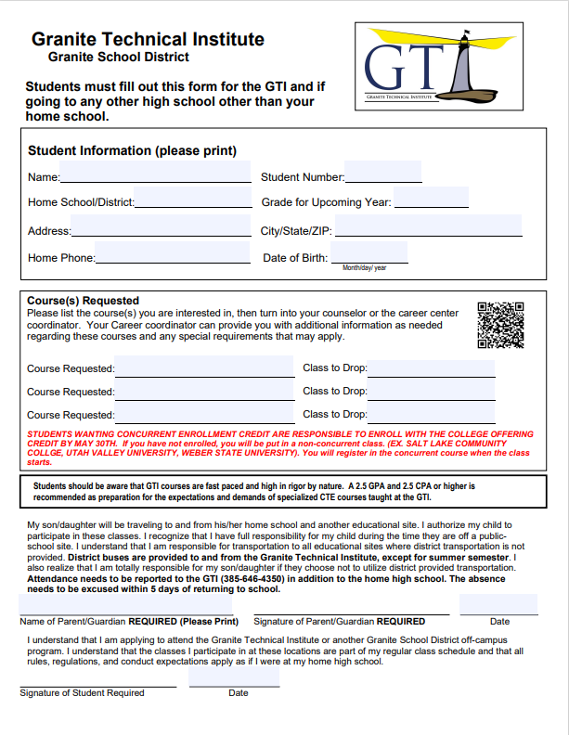
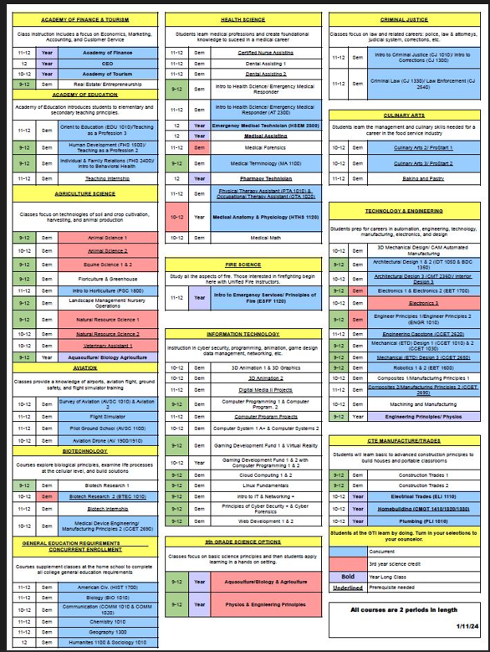

Slide 16
Learn more about GTI by watching this video

Slide 17
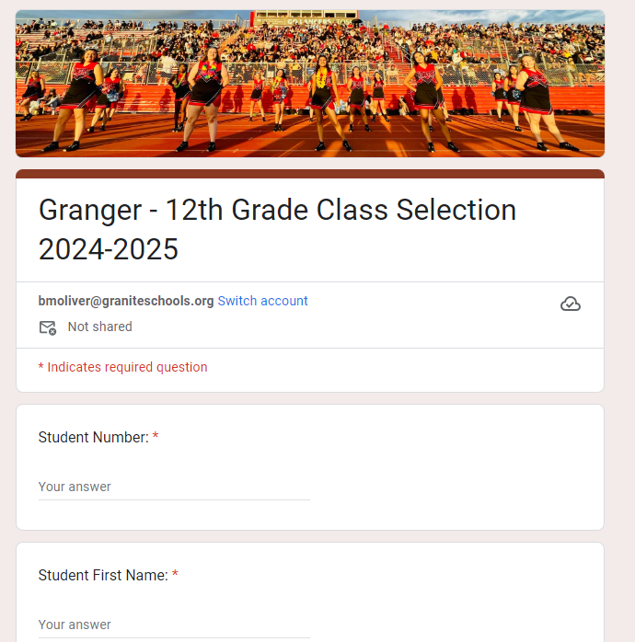
Now it’s time to choose your classes!
Make sure you fill out your first name, last name, and student number.
Remember AP classes are a semester commitment
AND CHOOSE 16 BOXES FOR A FULL SCHEDULE

Slide 18
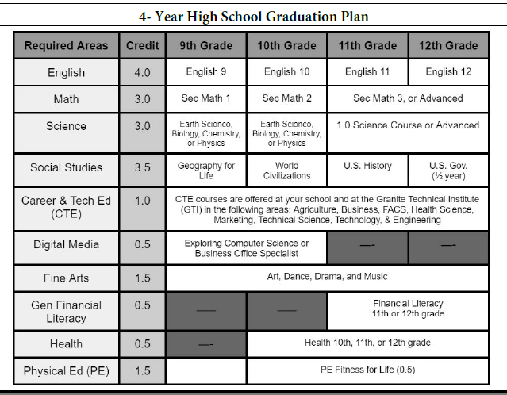
Look at your PTG
Make sure you are taking the classes you need for graduation.

Slide 19
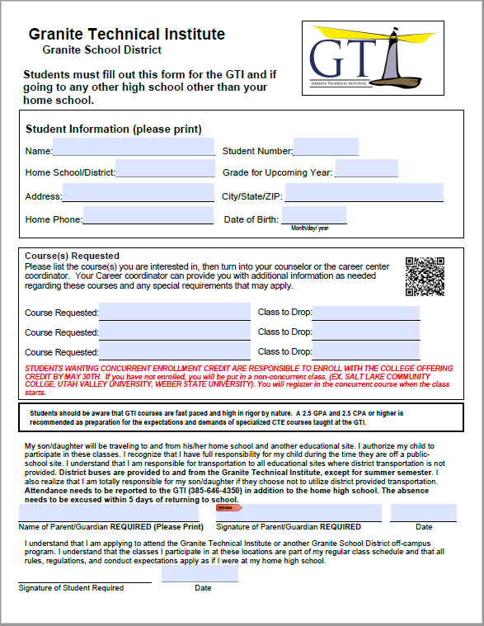
Click the button if you are intersted in taking GTI
Remember you must turn in a GTI application to take GTI classes!

Slide 20
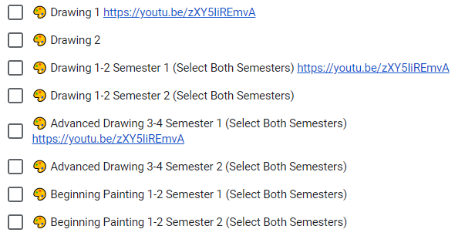
Don’t forget! Choose 16 boxes for a full schedule
S = Semester Class will be one box
Y= Year Class will indicate you need to choose two boxes and say (Select Both Semesters)
Choose your classes wisely.

Slide 21
How many boxes do you need?

Slide 22
16

Slide 23
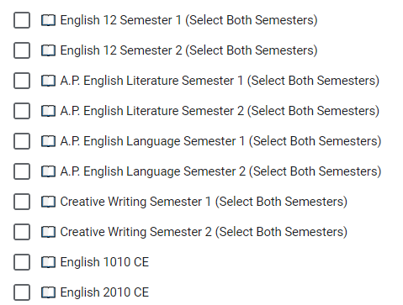
Let’s choose an English class
You need a year of Senior English and you have some choices:
English 12
AP English Literature
AP English Language
English Concurrent Enrollment 1010 and 2010. You need to take both and have an ACT of 18 in reading for English 1010
Choose two of the same boxes.

Slide 24
Let’s choose a History class
You need a half year of government for graduation.
Choose Government
Or AP Government (remember this requires a commitment)

Slide 25
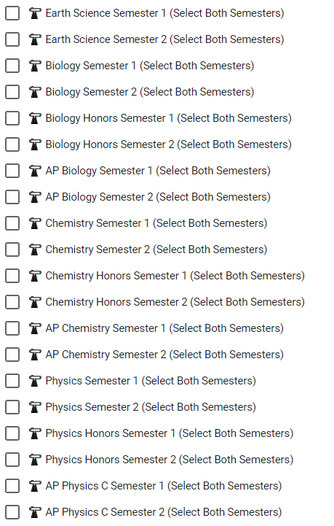
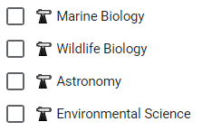
It’s a good idea to take science
Check your PTG to see if you need science
Make sure you take a science you have not taken before
Take science because it will make you more prepared for college
Take AP or CE science because it could help with the Opportunity Scholarship and better prepare you for college

Slide 26
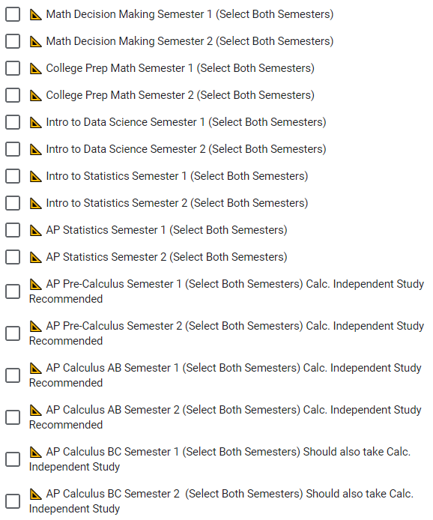
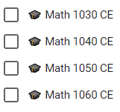
It’s a good idea to take math
Check your PTG to see if you need math and make sure you take a math you have not taken before
Take math because it will make you more prepared for college
Take a fourth year of math because it could help with the Opportunity Scholarship and better prepare you for college
Math students must have taken Secondary Math 1, 2 and 3 with a C or better OR a qualifying score on the ACT [19 for 1030; 22 for 1040; 23 for 1050; and success in 1050 or an Accuplacer test for 1060]

Slide 27
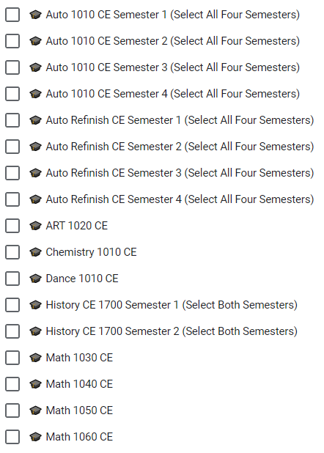
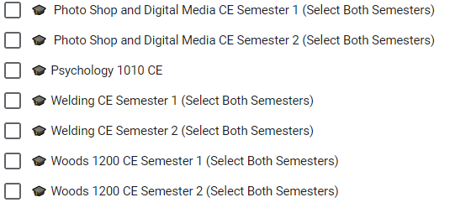
Consider Concurrent Enrollment
Concurrent enrollment earns you credit for both high school and college.
Keep in mind that concurrent enrollment can affect your college transcript so make sure you are committed to those classes
You will need to register for the college to take the class (about a $40 fee) and then pay a fee for credits (between $15 and $25)

Slide 28
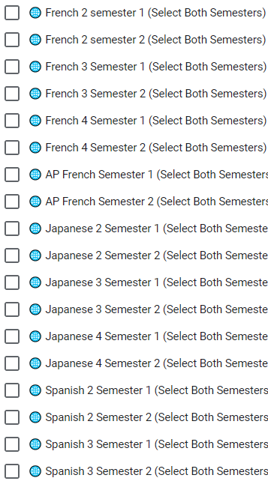
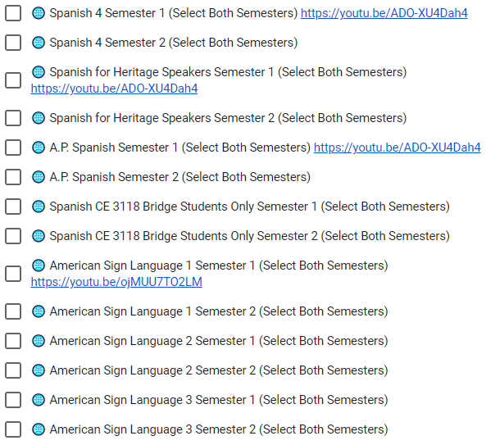
Continue with a Foreign Language
Foreign Language is a good idea for college.
You can also continue with a language you have taken previously
Two years of the same foreign language better prepares you for college

Slide 29
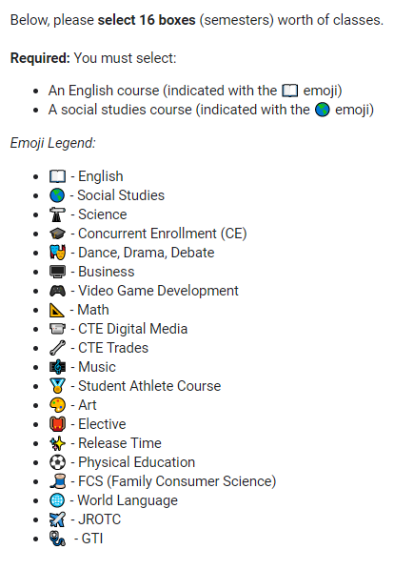
Now go ahead and choose your classes
Make sure you choose sixteen boxes.
Make sure you are taking classes to graduate.
Make sure you are taking classes to help you prepare for life after high school.
Challenge yourself! Get college and career preparedness.
Make the most of your senior year!

Slide 30
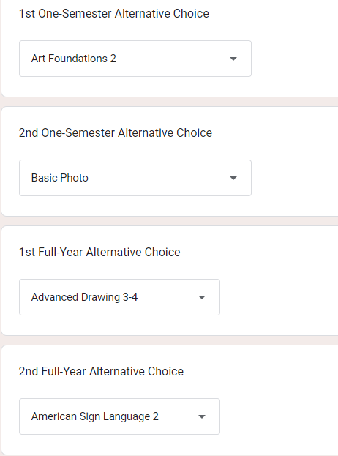
Don’t Forget!
Make sure you choose alternates in case classes get cancelled or are full.

Slide 31
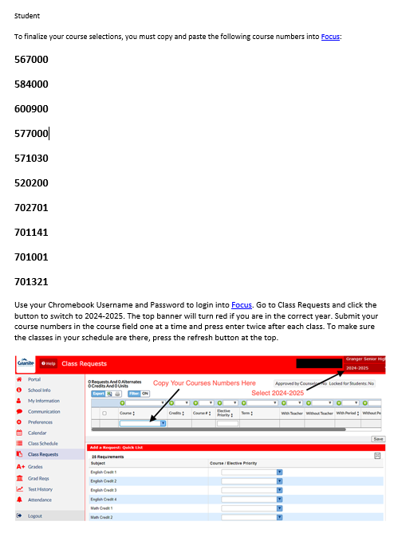
Now CHECK YOUR EMAIL
You will receive an email of the classes you chose
YOU’RE NOT DONE YET!
After you get the email you will need to log into FOCUS and enter your choices there!

Slide 32
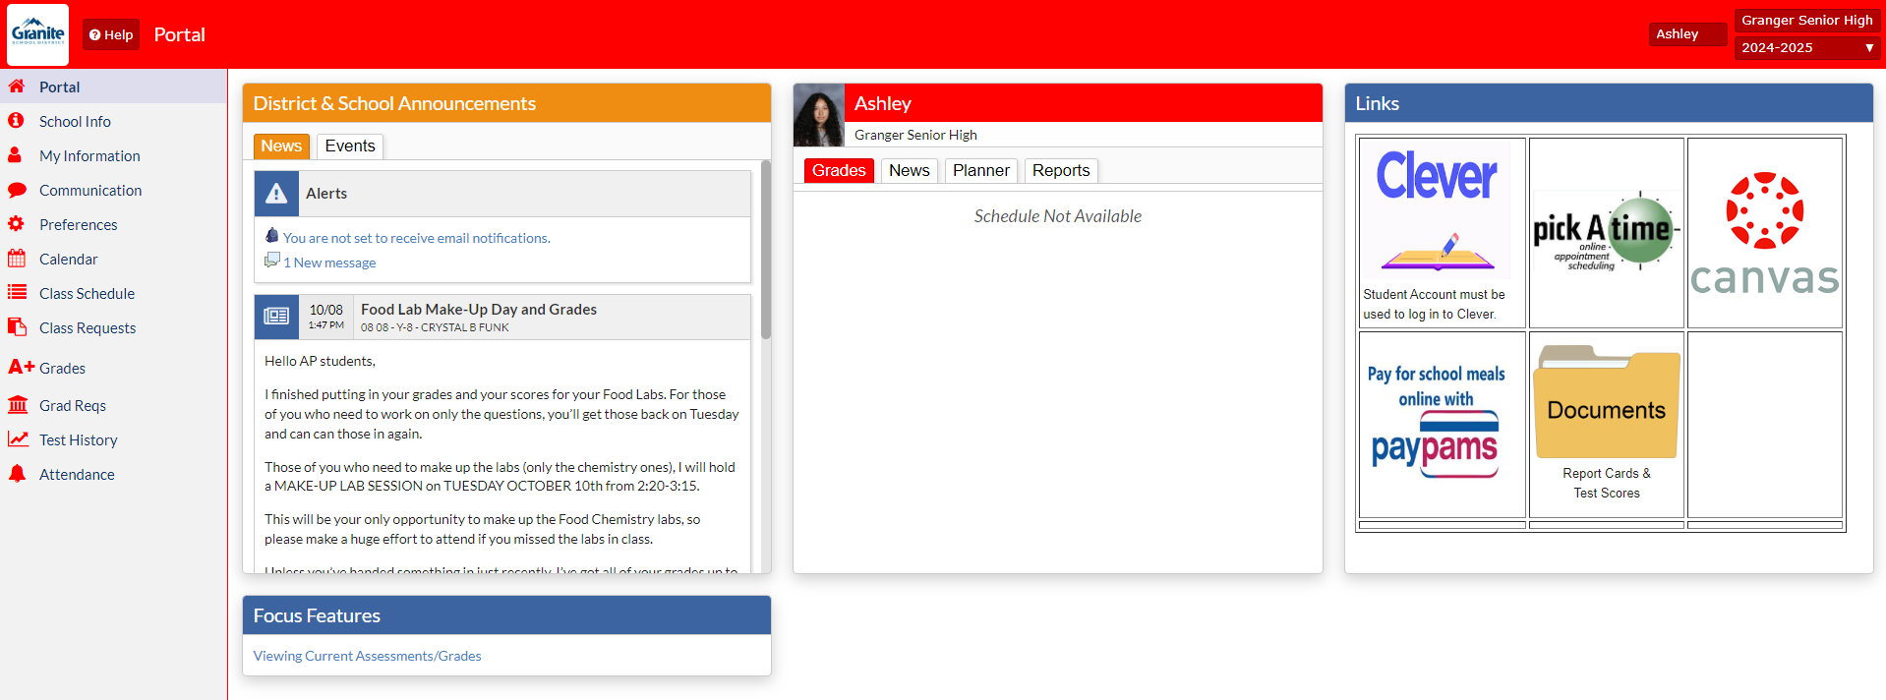
Now go to FOCUS and log in and go to class requests

Slide 33
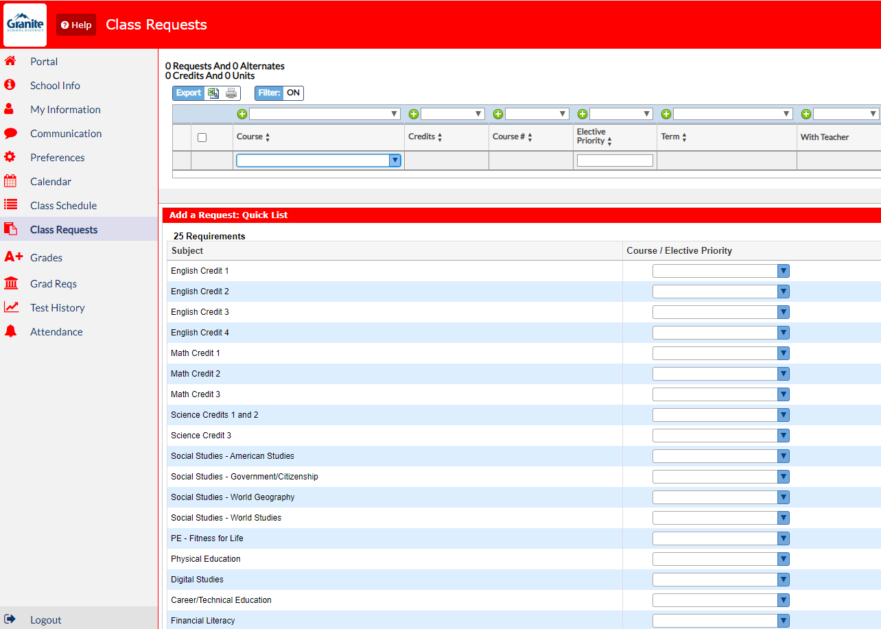
This is where you will add the numbers from your email

Slide 34
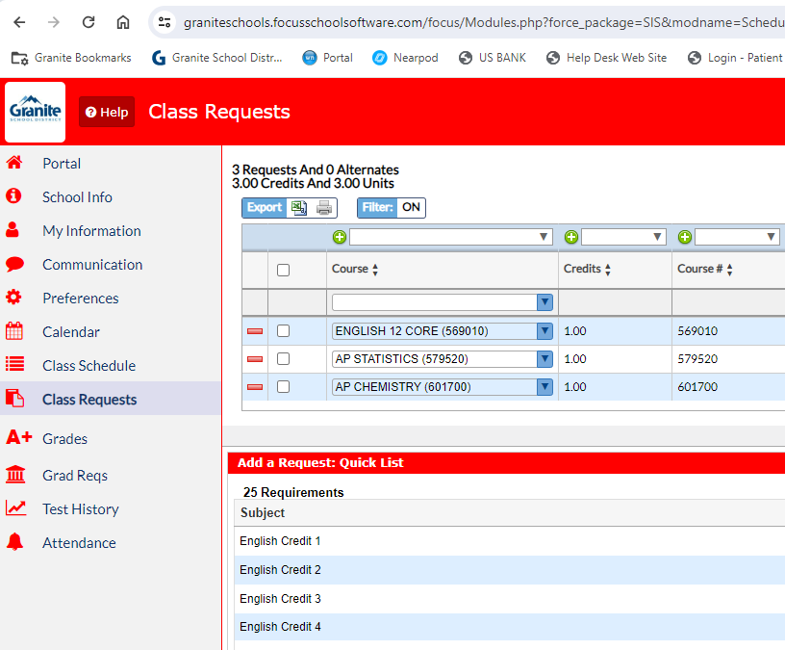
Enter the numbers for all classes you chose
Once you have entered the number press enter twice
Press reload to make sure the class is in your schedule
Once you have 8 credits that’s it! You have put in all your classes

Slide 35
8 Credits? Good Job!

Slide 36
Let’s Review
* You have 4 alternates filled out in case classes are full or canceled
*NO TA, HOME RELEASE, SPORTS, or TRYOUT CLASSES
* You are taking classes that prepare you for college, a job and/or the Opportunity Scholarship
* Make sure you get your GTI application in ASAP
*Make sure your name and student number are filled out correctly
*You've filled 16 boxes which include:
* English (2 boxes)
* Government (1-2 boxes)
* ALL REQUIRED CLASSES

Slide 37
Contact your counselor or the counseling center if you have any questions or concerns.
385-646-5321

