Slide 1
You’re a Senior!
The everything you need to know presentation…

Slide 2
Make a plan for graduation

Slide 3
Make sure you graduate from high school
Make a plan for graduation
Check your credits and make sure you and your counselor are on the same page
Attend your College and Career Readiness Meeting in September or October – bring your Folks!
Check for three things on your PTG
1. CPA
2. Basic Civics Test
3. Taking the credits you need for graduation
And talk to your counselor about credit recovery if you need it…

Slide 4
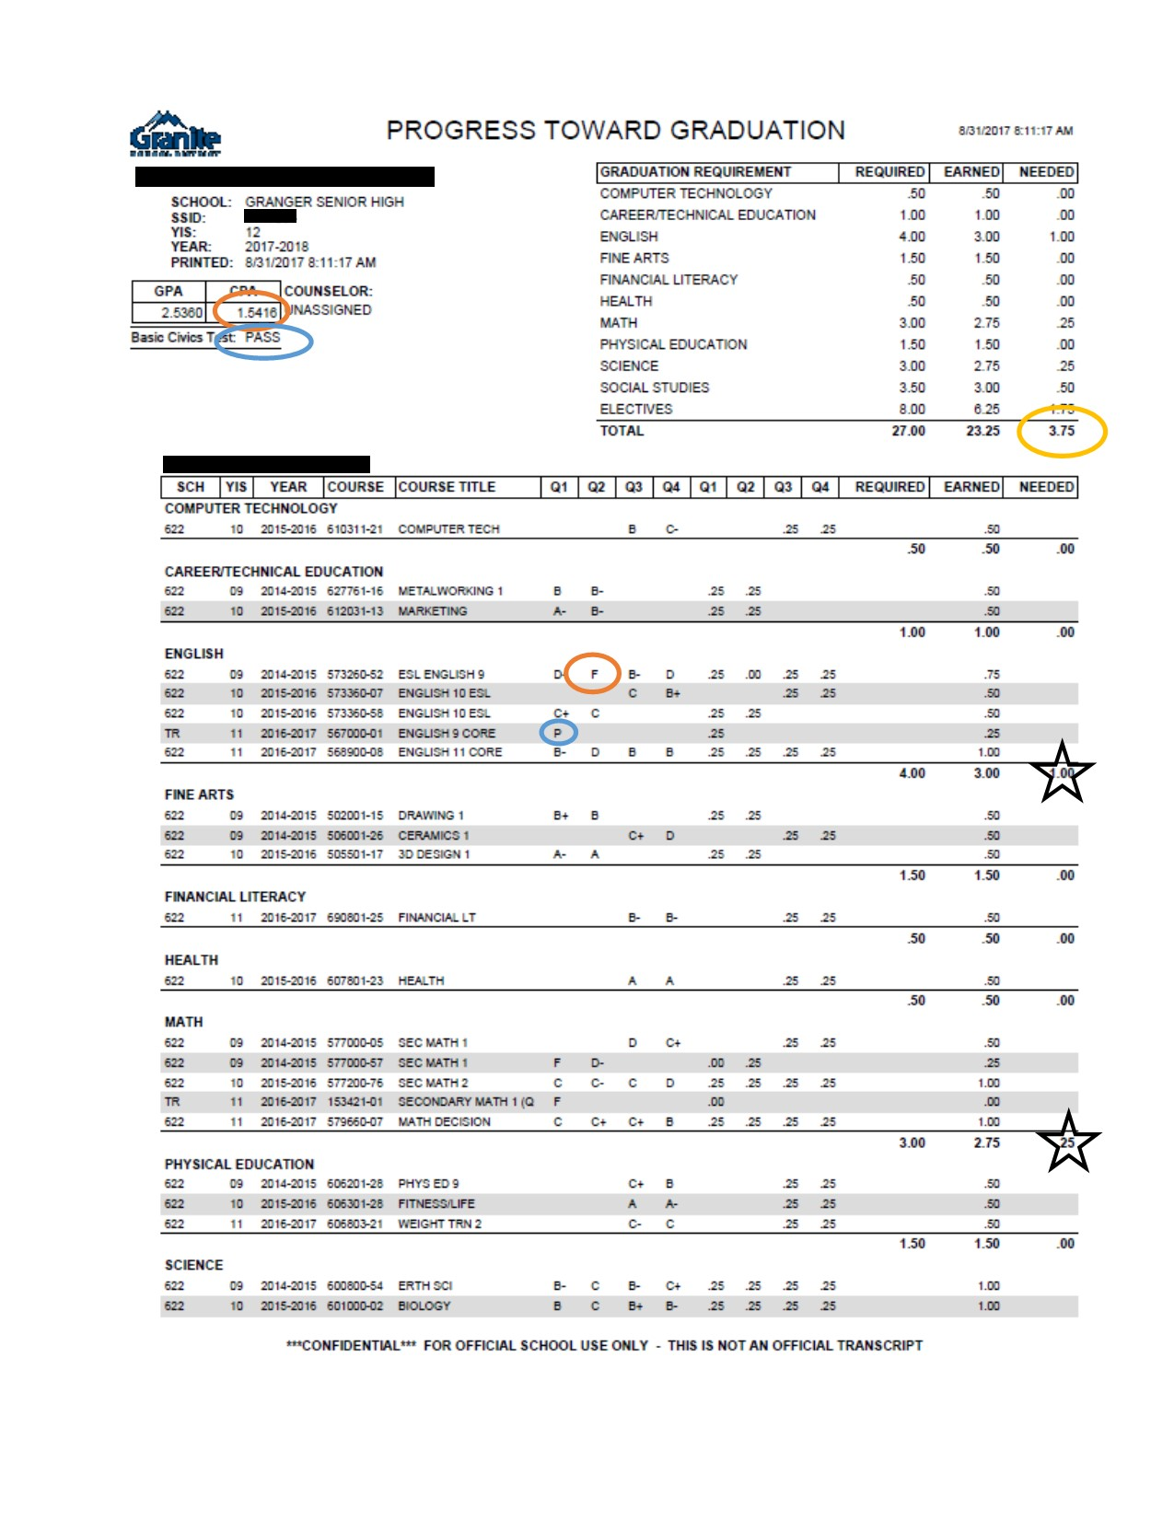
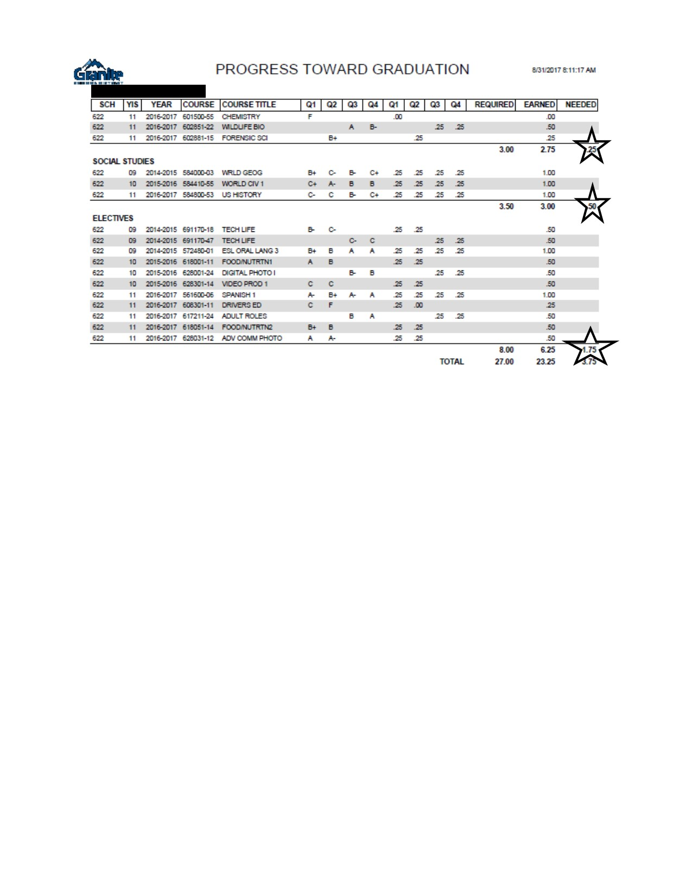

Slide 5
Get on track to graduate!
For CPA, work on being In Class and On time to class to bring up your CPA. You will get a list of the hours you will need to make up if you do not have a 2.0 by the end of 1st quarter.
You can make up CPA by getting 4’s in CPA, staying after school, attending the worth of education class and by donating blood.
If you have not passed or taken the basic civics test, talk to your government teacher or Mrs. Asay in the library.
If you need credit recovery, talk to your counselor as soon as possible. Make a plan for graduation.

Slide 6
Make a plan for what to do after you graduate

Slide 7
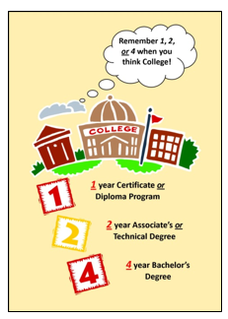
What is 1, 2, 4, or more?
College isn’t only 4 years
1 year – Certificate or Diploma Program
These programs prepare students for jobs after high school and typically finish in a year. (Utah College of Applied Technology)
2 year – Associate’s or Technical Degree
Two year training program. (Salt Lake Community College)
4 year – Bachelor’s Degree
A degree awarded by a college for three to five years of study. (UofU, BYU, UVU, Weber)

Slide 8
These jobs only require a certificate
Certified Nursing Assistant
Automotive Technicians
Cosmetologists
Heavy Diesel Technician
Networking Technician
Medical Billing and Coding
Firefighter
Surgical Tech
Plumbing Apprentice
Digital Media Designer
Nail Technician
Culinary Arts
Medical Assistant
EMT
Electrician Apprentice
Software Developer

Slide 9
These jobs only require an Associate’s
Mechanical Drafters
Web Developer
Medical Sonographer
Respiratory Therapist
Executive Assistant
Electrician
Plumber
Paralegal
Sound Engineer
Machine Repair Technician
Medical Records Technician
Construction Management
Radiation Therapist
Air Traffic Controller
Dental Hygenist
Aircraft Mechanic

Slide 10
These jobs require a bachelor’s degree
Research Analyst
Financial Advisor
Cartographer
Translator/Interpreter
Forensic Science Technician
Biomedical Engineers
Athletic Trainer
Computer System Analyst
Social Worker
Engineering
Teacher
Fashion Merchandising
Nutritionist
Interior Designer
Marketing
Accounting

Slide 11
You can go to college
Put aside any doubts you may have, and start believing in yourself. Even if you don’t have the best grades, you can still attend college and graduate.
Different colleges have different admissions standards. In Utah, there is a college that is right for you.
Several schools have open admissions policies, which means they will accept all students who apply. A two-year community college may be a great place to get started on your college education.

Slide 12
For Profit Vs Not for Profit
Why haven’t I received any brochures from colleges I want to go to?
Some colleges may advertise to you more than others. Why?
For Profit colleges are owned by a business or share holders
Sometimes more expensive
Credits may not transfer to other schools
Examples: Broadview, Eagle Gate, Fortis, Neumont, Steven Henager, Art Institute, Wyotech
Not for profit colleges are owned by the state
Often less expensive – funded by the government
Credits are typically transferable
Examples: University of Utah, SLCC, Weber State, Utah State University, Dixie State University, Snow College

Slide 13
Attend College Day!
College Day is Tuesday, October 17th
You will have a chance to meet with 3 colleges
You will need a bar code that you will register for today at the end of this presentation
You will apply to college November 6-10 in your English classes

Slide 14
Want to go to college outside of Utah?
Attend the Rocky Mountain Association for College Admission Counseling College Fair
When? Saturday, September 23rd
Where? Juan Diego Catholic High School
Workshops from 10:45-12:20
College Fair from 1:00-3:30

Slide 15
Consider taking the act again
Take the ACT again on October 28th
Sign up September 15th at 2:30 in the Career Center
Questions? Talk to Jeanette Hernandez in the Career Center
The test is $42.50 but fee waivers are available with Jeanette Hernandez

Slide 16
How do I pay for college?

Slide 17
What is fafsa?
FAFSA (The Free Application for Federal Student Aid) is the application you submit in order to get financial aid to help pay for college. You can submit it as early as October 1st, 2017. The sooner you submit your FAFSA, the sooner the information gets to your college and the sooner you’ll be able to find out what financial aid you qualify for.

Slide 18
What is the difference between FAFSA and scholarships?
FAFSA can qualify you for three things:
1. grants – free money for college up to $5,920
2. loans – money that needs to be paid back
3. work study – part time employment on campus while enrolled in school
Scholarships are free money for college through individual applications. The more scholarships you’re able to get the less money you’ll have to find elsewhere.

Slide 19
Places to look for scholarships
https://utahucac.wordpress.com/
https://www.fastweb.com/
https://www.unigo.com/
http://www.dsaz.org/
http://utahcf.org/apply-for-support/student-scholarships
http://chci.org/education/the_national_directory_of_scholarships_internships_and_fellowships_is_now_online/
https://educate-utah.org/scholarships/
https://www.chegg.com/scholarships#
https://www.petersons.com/#/sweeps-modal
http://www.collegeresourcenetwork.com/

Slide 20
Come to a FAFSA night at Granger high
You won’t know what you will get unless you fill out the FAFSA.
Join us in the Career Center on the following dates:
October 11th 5-8
November 15th 5-8
December 13th 5-8

Slide 21
What do you need to fill out the FAFSA?
Your Social Security Number
An email address (not your school email)
Driver’s license (if you have one)
Tax return for last year or access to it through the IRS website and your parent’s tax return and access to it
You may also need your parent’s marriage or divorce dates, your parent’s social security numbers and email address

Slide 22
Let’s get you a bar code for college day

