Slide 1
Suicide Awareness
From your Friendly Neighborhood Counselors
Notes:
Hey guys. Today we thought we would come down and talk a little bit about suicide awareness. Please feel free to raise your hands, make comments and interact with the presentation. It helps make this more of a discussion and we get more out of it all together than just listening to us counselors talk the whole time. Please feel free to take notes.

Slide 2
What we will be learning today
1. Why we are discussing this
2. Utah Statistics
3. Warning Signs
4. QPR
5. Coping Skills
6. How and where to get help

Slide 3
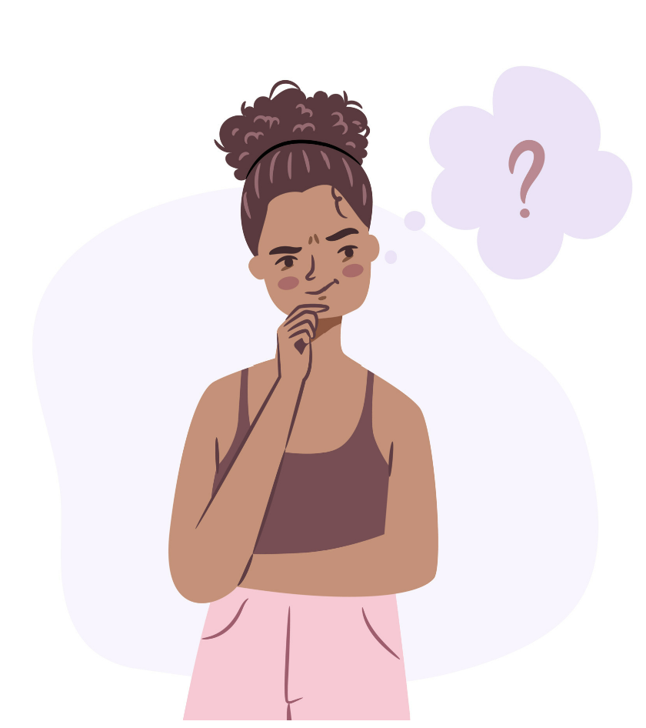
Why is it important to talk about suicide?
To bring awareness
Knowing when and where to get help
Helping those around you

Slide 4
Utah Statistics
#1 Cause of death in Utah for ages 10-24 years (2020).
#2 cause of death for Utahns ages 25-44 years.
Average 648 deaths per year.
Notes:
What are your guy’s thoughts on why Utah has such high suicide rates? Any thoughts?
Ex:
Religious pressure
Guns
Conformity

Slide 5
Why so high?
Western states have greater access to firearms.
UT families move more often = feeling isolated.
Religious pressure.
Unemployment
Social Media/Technology/Media
Notes:
I think you guys named a lot of the points on this list.

Slide 6
According to the 2019 Utah Prevention Need Assessment in Utah Schools
On average, a classroom of 30 Utah students may have:
6 students who seriously considered attempting suicide in the last year.
4 who made a suicide plan in the last year
3 who attempted suicide in the last year
Notes:
In a normal class size about as big as the one we are in right now.
Knowing that you or someone you know is going through this, how can we all be more connected and willing to help those around us?

Slide 7
Myths
“A person who threatens suicide won’t really follow through. They’re just trying to get attention.”
“Talking about suicide might prompt the person to act.”
“Once they decide to commit suicide nothing can stop them.”
“People who attempt really want to die.”
Notes:
Common Myths about suicide

Slide 8
Concerning Thoughts or Statements
Saying “I’m good” when I might not actually be feeling good.
“I don’t want to be here anymore”
“I am tired, and I feel like giving up”
“I don’t want to be in this world anymore”
“Nobody will care if I am gone”

Slide 9
Warning Signs
Sad/Depressed
“feeling down”
Withdrawal
Feeling like you cannot improve things (helplessness)
Feeling alone (loneliness)
Emptiness
Feeling like things won’t get better (hopelessness)
Loss of interest
Personality change/Reckless Behavior

Slide 10
QPR
Asking direct questions is one of the best ways to help others open up, and start an important dialogue that could save their life.
I haven’t seen you around lately, are you doing ok?
I feel like you want to tell me something, what is going on?
Are you thinking about suicide?
You seem stressed. Can I help you with anything?
You seem down. Is everything ok?
Q =Question
Notes:
As counselors we came up with this acronym called QPR. It’s easy to remember like CPR. QPR stands for Question, Persuade, and Refer.
In the question phase we are collecting information. We need to find out the severity of the situation by asking these questions. Do they have a plan? Have they obtained items to carry out that plan? And have they decided on when they will carry out that plan?
After we do this we persuade them to get help and take them to a trusted adult that can get them help.
Who are some adults you can get help from?

Slide 11
P=Persuade
Listen to what they have to say-Convince them to get help.
Will you go with me to see a counselor?

Slide 12
R=Refer
Take them to a person who can help
School Counselor
Parents
Admin
Teacher

Slide 13
Do Not
Use guilt or threats to prevent suicide.
Sidestep the issue
Leave the person alone
Keep what you know a secret – if they make you promise – tell them you are acting to keep them safe and that you care about them.

Slide 14
Do
Take every threat seriously
Tell the person you are concerned and want to help.
Express empathy for what they are going through.
Be nonjudgmental of mental health issues.
Be a good listener.
Show that you care.
Get professional help.
Notes:
I can not stress enough the importance of taking any comment about suicide seriously. Even if a friend or someone is joking, we as counselors have to take it seriously because we cant let it be the one that ends up being true and that person not getting help.

Slide 15
If you are considering suicide
Remember:
STOP. BREATHE.
You are not alone
The crisis will pass
Talk with someone you trust.
Say “I NEED HELP NOW.”
Notes:
Remember to stop and breath. Take deep breaths and count down from 5. You are not alone, this crisis will pass, talk with someone you trust, and say “I need help now.”

Slide 16
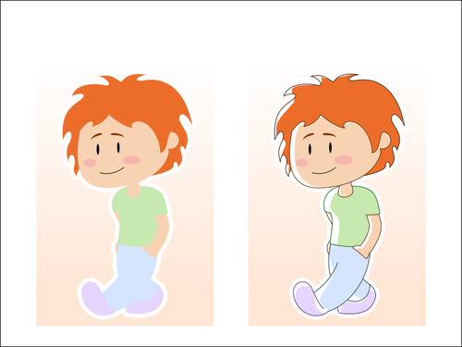
Some people find the following helpful when having thoughts of suicide
The ability to cope or solve problems reduces the chance that a person will become overwhelmed, depressed or anxious.
Use your Coping skills. Examples might be:
Relaxation techniques
Exercise
Deep breathing
Call/text a friend or loved one
Find distractions
Go on a walk
Watch your favorite movie
Go somewhere you feel safe
Visit a friend or loved one
Visit your favorite place/store
Make your environment safe

Slide 17
Reach Out - Preventing Teen Suicide

Slide 18
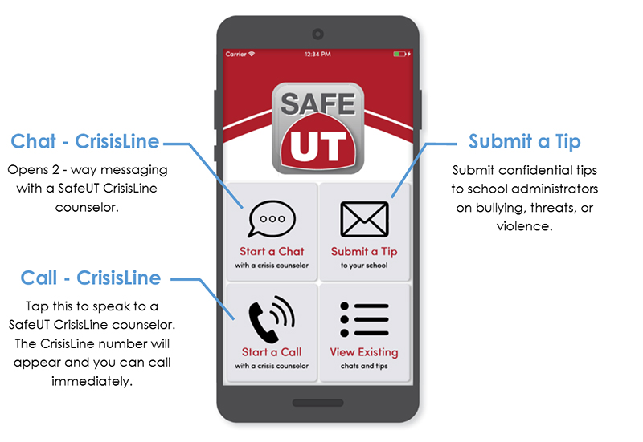
Where can you get help?
Contact someone you know and trust
Call a hotline 988 Suicide and Crisis Lifeline
SafeUT App
Contact your doctor, counselor or social worker, admin, teacher
TELL SOMEBODY

Slide 19
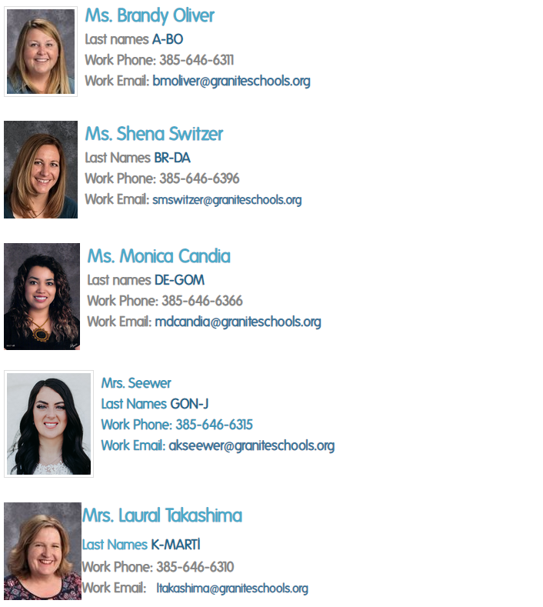
Granger Counselors

Slide 20
Activity
Fill out the wellness plan.
Keep it safe to look at when needed.
Meet with your counselor today or they will pull you down in the next week for your CCR.

