Slide 1
Welcome to Class Selection for Freshmen
Class of 2028

Slide 2
You’re about to be a Freshman!

Slide 4
We have a few tasks for you today
Look at the credits you need for graduation
Select your classes for next year
Ask questions about High School!

Slide 5
You are the graduating class of 2028!
There are many things available to help you be successful this year:
Do your best! Get good grades and practice good study habits
You will have a College and Career Readiness Plan (CCRP) with your counselor every year
Freshman Success is a required class that will help you with the transition from junior high to high school
Your grades and CPA count in 9th grade. Attendance, grades, and behavior count in high school.
Get involved! Granger High is a fun place to be!

Slide 6
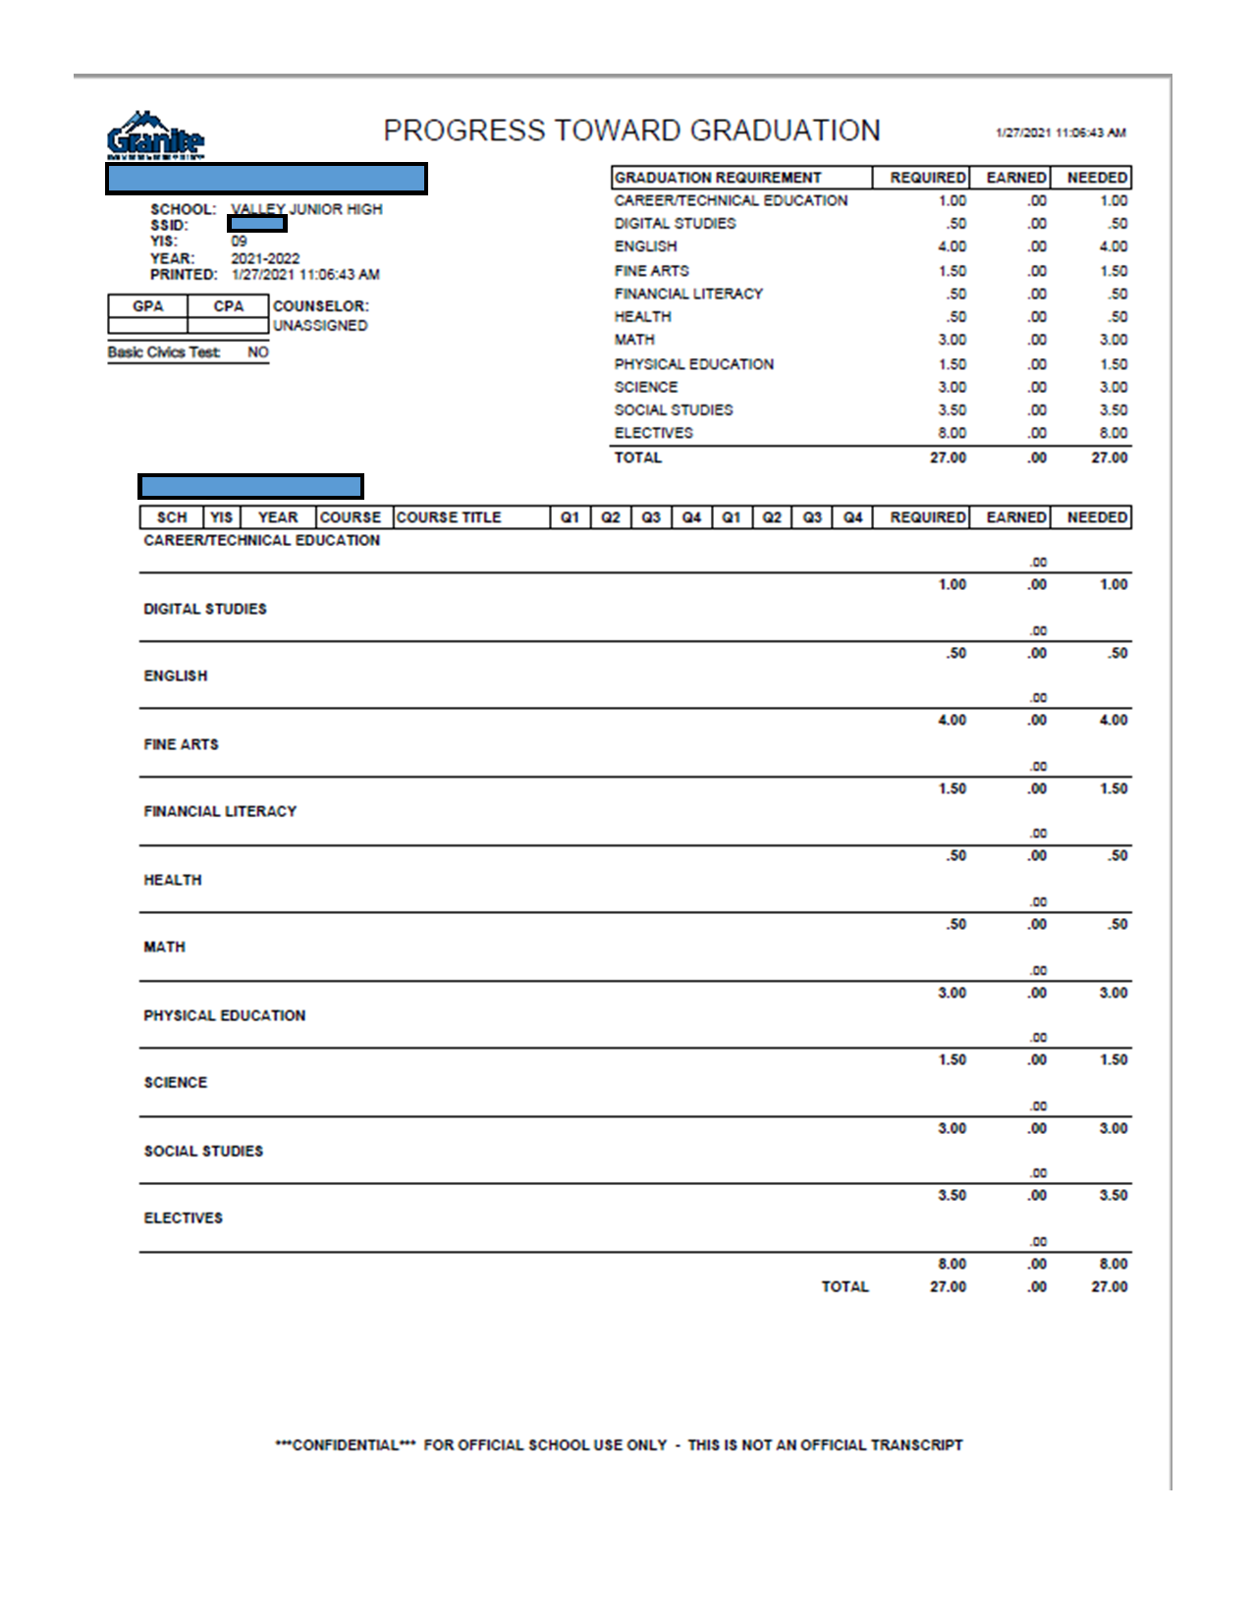
When you are in high school you check your credits on your PTG (Progress Toward Graduation)

Slide 7
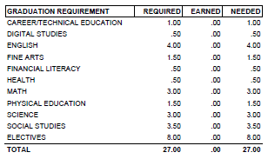
For graduation you need the following credits:

Slide 8
You also want to be aware of your GPA, CPA, and Basic Civics Test

Slide 9
Some things to keep in mind when choosing classes:
Choose classes that connect to your interests
* What are you interested in taking?
* What do you want to do after high school?
Choose classes that connect to your abilities
* What are you good at doing?
* What skills do you want to refine?
ALL YOUR CREDITS COUNT - SO PLAN ON PASSING ALL CLASSES
DO NOT:
* Choose classes your squad wants you to take with them.
* Take classes with your boyfriend or girlfriend (because it's SUPER awkward when you break-up)

Slide 10
You can take classes to help you get ahead:
Honors - rigorous classes that prepare you for college
Advanced Placement (AP) - college level classes and you can receive college credit if you pass the AP test at the end of the year
Freshmen can take AP Spanish or AP Geography. AP classes are best paired with AP Independent Study. Since AP Geography is a college class, you will need a study class with it.

Slide 11
AP Expectations:
• AP independent study class
• Read at home and in class
• Work in class/Come to class prepared
• Communicate with the AP teacher
• Manage time wisely

Slide 12
Granite Technical Institute (GTI)
* Hands on classes taken off campus (you take a bus there...it's like a field trip!)
* YOU NEED TO FILL OUT A PERMISSION SLIP TO TAKE THESE CLASSES & IT'S ON A FIRST TURNED IN, FIRST IN CLASS BASIS
*Put GTI in the alternates section of your class selection card and we will let you know if you made it in the class
*Get your permission slip to your counselor or Mrs. Petty in the Career Center ASAP. You can also fill it out at Grangercounselingcenter.com and email it to your counselor

Slide 13
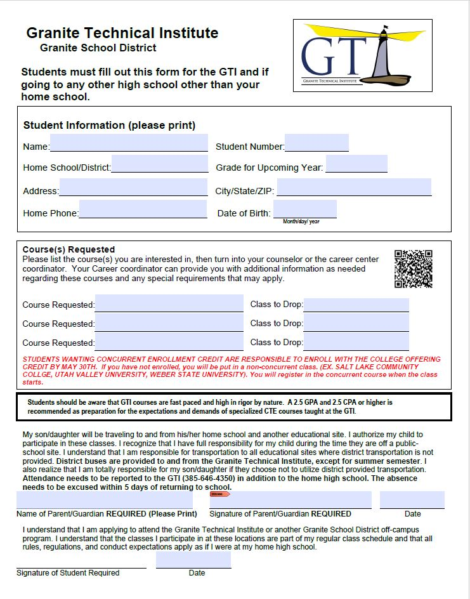
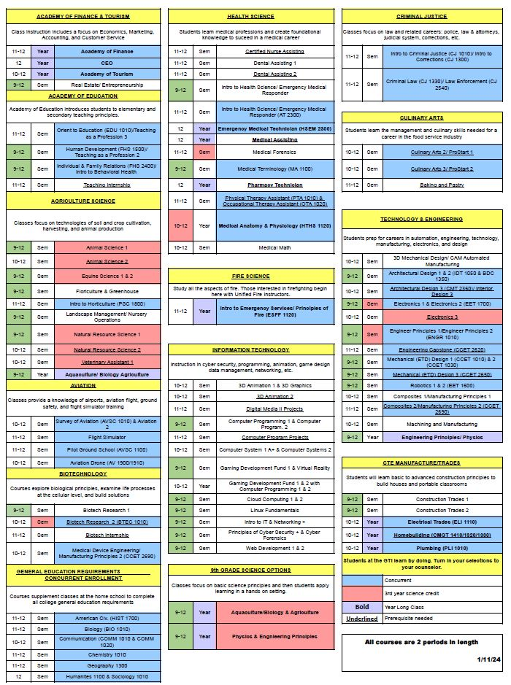

Slide 14
Learn more about GTI by watching this video

Slide 15
Add desired GTI classes here
Remember you must turn in a GTI application to take GTI classes!

Slide 16
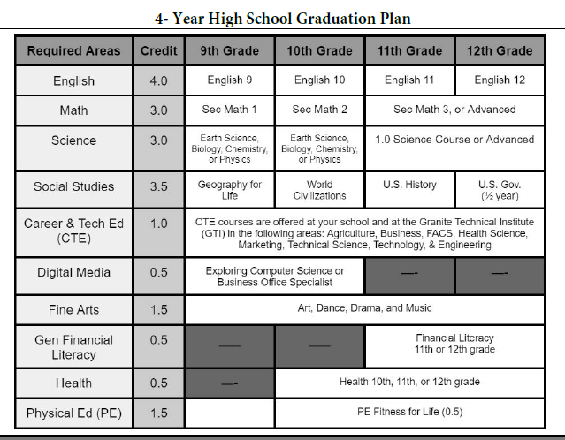
Look at your PTG
Make sure you are taking the classes you need for graduation.

Slide 17
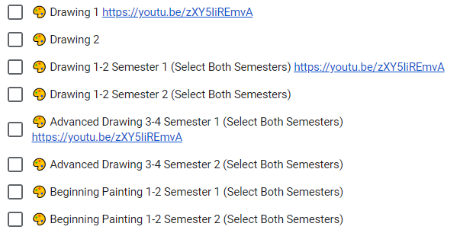
Don’t forget! Choose 16 boxes for a full schedule
S = Semester Class will be one box
Y= Year Class will indicate you need to choose two boxes and say (Select Both Semesters)
Choose your classes wisely.

Slide 18
Now go to grangercounselingcenter.com
Go to class selection
2024-2025

Slide 19
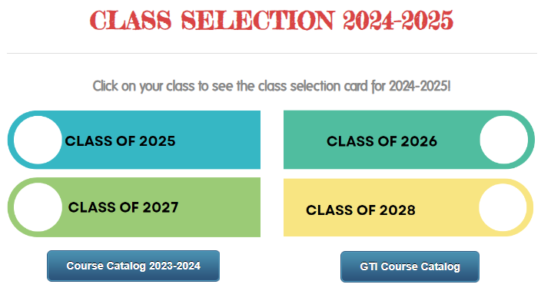
Now go to Class of 2028
On this page you can click the course catalog and see what each class is about
You can also look at fliers for each class at Granger and see what teachers have to advertise about each class
Make sure you click on CLASS OF 2028
You will fill out your class selection there.

Slide 20
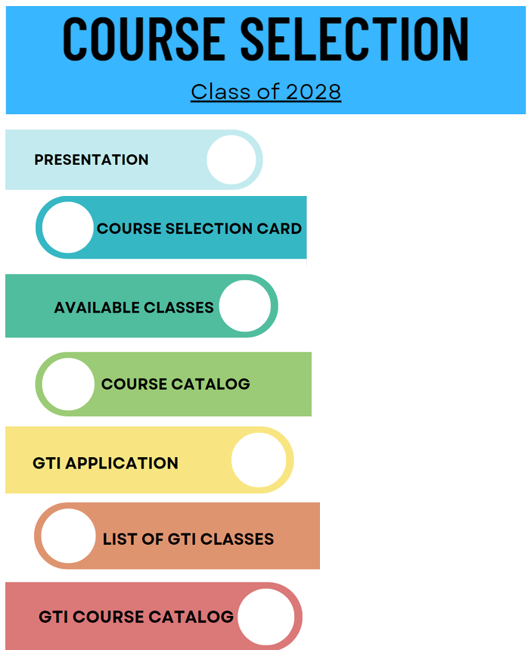
Freshmen Class of 2028
Here you will find this presentation
You will see a video about Granger
You will find the GTI application
YOU WILL PICK YOUR CLASSES FOR 9th GRADE

Slide 21
CLICK HERE TO PICK YOUR CLASSES FOR 9th GRADE
This is where you will choose your classes for next year.
Make sure you are taking classes you need for graduation
Make sure you choose alternate classes.

Slide 22
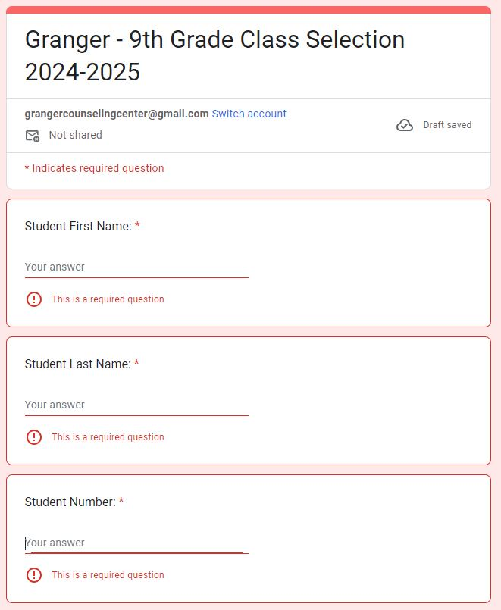
This is the google form. FILL THIS OUT.

Slide 23
How many boxes do you need?

Slide 24
16

Slide 25
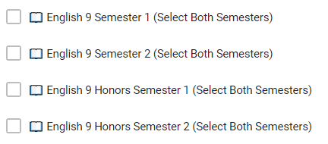
Let’s choose an English class
You need a year of Freshman English and you have some choices:
English 9
English 9 Honors
Choose two boxes of the same class.

Slide 26
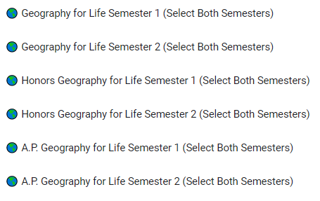
Let’s choose a History class
You need a year of World Geography for graduation. You can choose:
World Geography
World Geography Honors
AP World Geography
Choose two boxes of the same class.

Slide 27
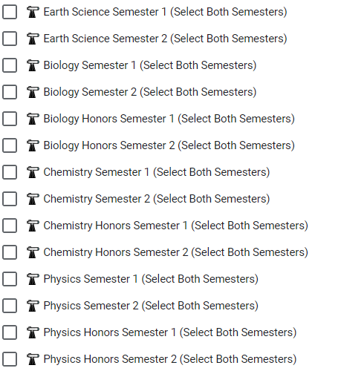
Let’s choose a science class
Take a science class. You need a full year.
You can take Earth Science, Biology, Chemistry, or Physics
Take science because it will make you more prepared for college
Choose two boxes of the same class.

Slide 28
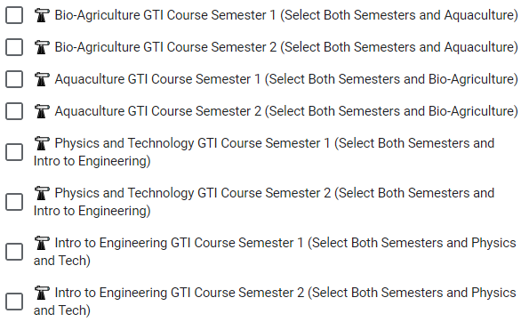
You can also take science classes through the GTI! They count for more science classes and count for more boxes. Make sure you get your GTI application in if you take these classes.

Slide 29
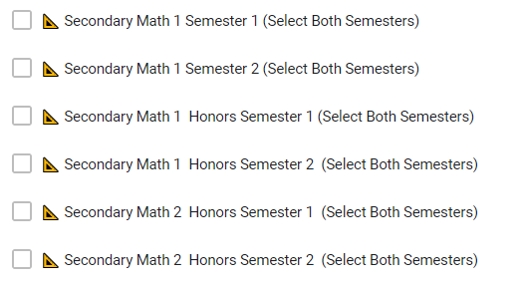
Let’s choose a math class
Choose a math class
Secondary Math 1
Secondary Math 1 Honors
Secondary Math 2 Honors
Choose two boxes of the same class

Slide 30
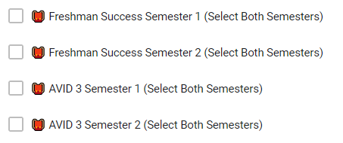
Take Freshman Success or AVID
Freshman Success is a class where you will learn about how to be successful in high school– students will learn how to communicate with teachers and check grades weekly
AVID is a class where you will learn organization and note taking skills. Students will also learn about leadership skills. Students taking AVID should plan to take an Honors or AP class.

Slide 31
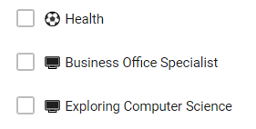
Two Classes You Should Consider Taking
Health is required for graduation and you should take it sometime in 9th or 10th. It is a half year
Business Office Specialist or Exploring Computer Science is your Digital Studies credit. You should take one during 9th or 10th. It’s a half year.

Slide 32
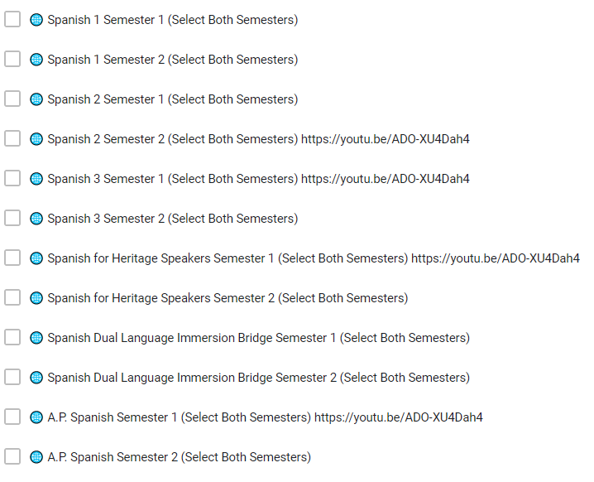
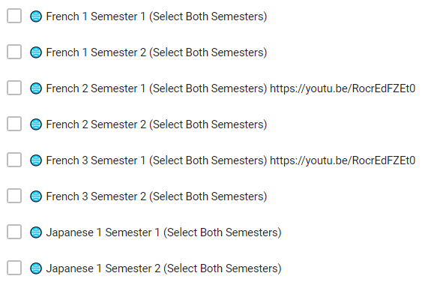
Take or continue with a Foreign Language
Foreign Language is a good idea for college.
Granger has four languages: French, Japanese, Sign Language, and Spanish
You can also continue with a language you have taken previously
Two years of the same foreign language better prepares you for college

Slide 33
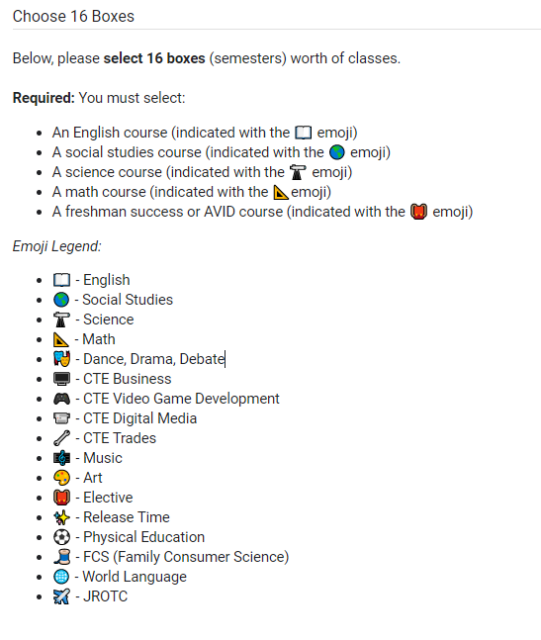
Now go ahead and choose your classes
Make sure you choose sixteen boxes.
Make sure you are taking classes to graduate.
Make sure you are taking classes to help you prepare for life after high school.
Challenge yourself! Get college and career ready!
Make the most of your freshman year!

Slide 34
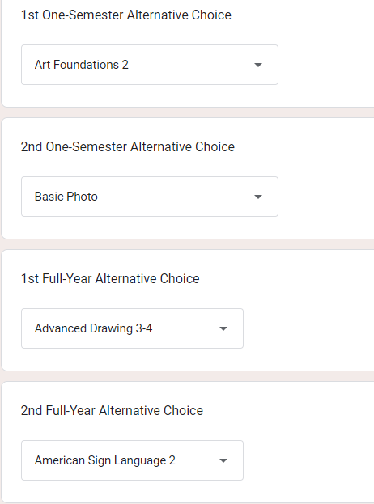
Don’t Forget
Make sure you choose alternates in case classes get cancelled or are full.

Slide 35
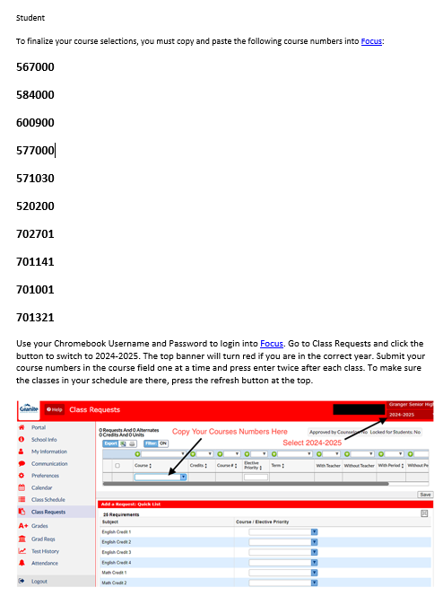
Now CHECK YOUR EMAIL
You will receive an email of the classes you chose
YOU’RE NOT DONE YET!
After you get the email you will need to log into FOCUS and enter your choices there!

Slide 36
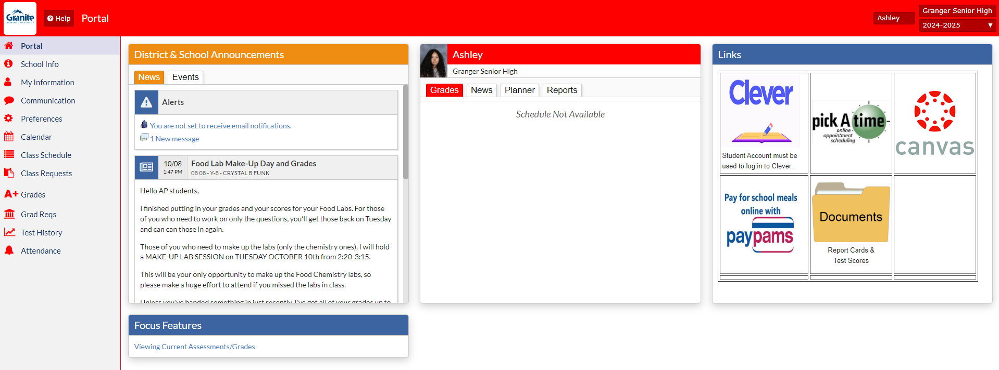
Now go to FOCUS and log in and go to class requests
You will then need to go to

Slide 37
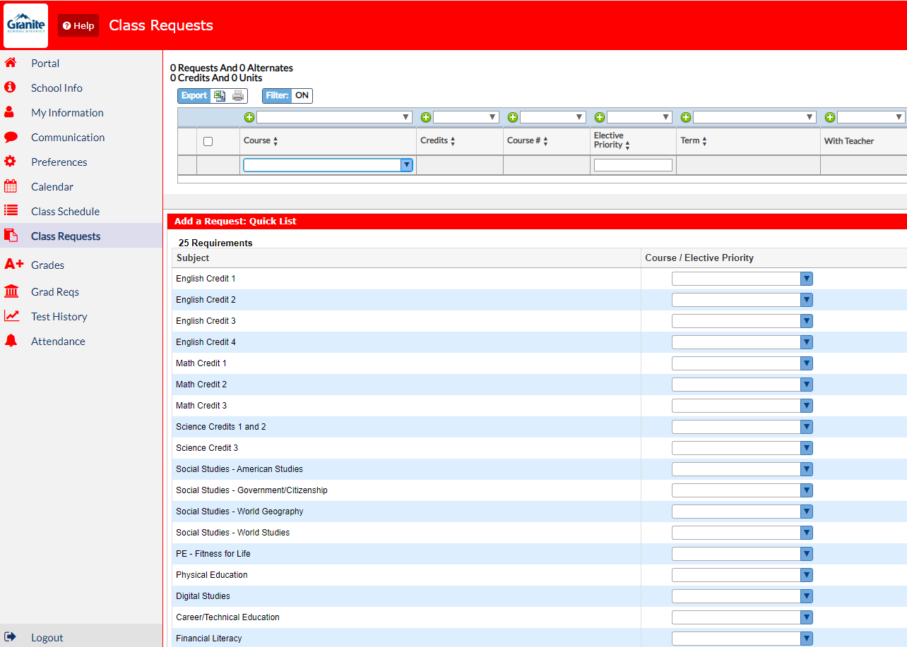
This is where you will add the numbers from your email

Slide 38
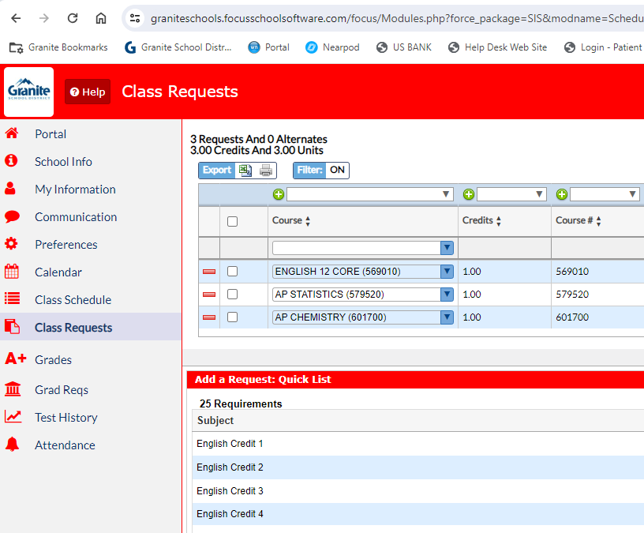
Enter the numbers for all classes you chose
Once you have entered the number press enter twice
Press reload to make sure the class is in your schedule
Once you have 8 credits that’s it! You have put in all your classes

Slide 39
8 Credits? Good Job!

Slide 40
Let’s Review
*Make sure your name and student number and current information are on your form
*You've filled 16 boxes
* English
*Social Studies
* Freshman Academy or AVID
* Science
*Math
* Fill out alternates
* Make sure you get your GTI application in ASAP

