Slide 1
Let’s Get Ready for the End of the Year!
Junior 4th Quarter Presentation 2024

Slide 2
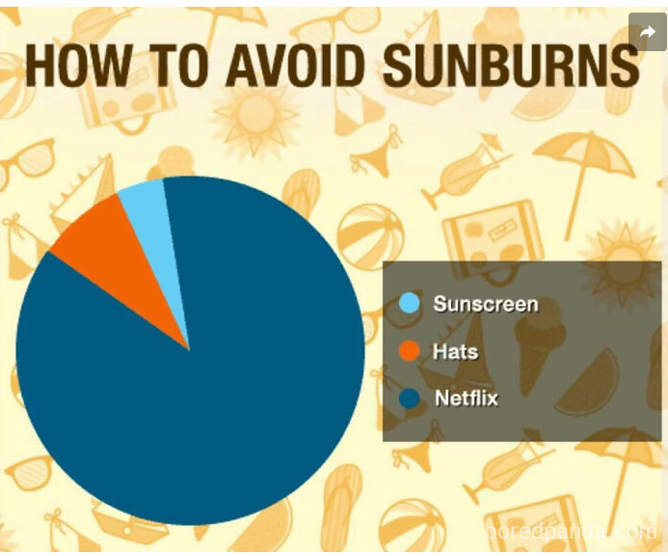
But first, let’s talk credits, summer school and service!

Slide 3
As a Junior you should have between 19.25 & 22 credits to be on track for graduation

Slide 4
You can attend Summer School to Recover Credits or Get Ahead!
When does summer school start?
Monday, June 3rd to Thursday, June 28th
You can take anywhere from one to four classes. Classes are 85 minutes each
If you attend four classes, classes are from 8:00-2:00
Summer school is free!
Sign ups begin Monday, April 8th

Slide 5
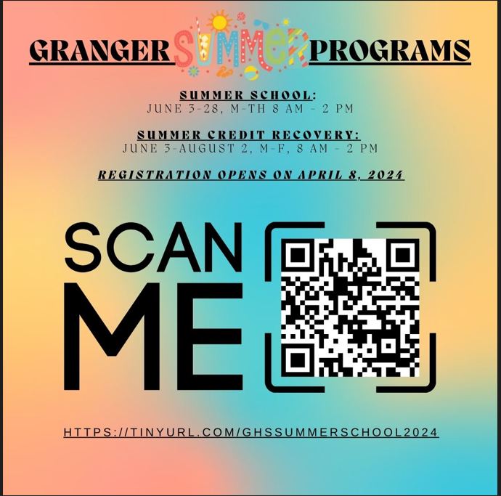
What summer classes can I take?

Slide 6
You can also take Summer School through Granite Online
See your counselor about taking classes online​ - Registration begins May 1-16
Go online to fill out a parent consent form beginning April 15
Each class is worth .50 credit
​Students may only take one class through Granite Online during summer but some exceptions may be made to take two
​Classes are $60. Fee waiver is accepted
Drivers Ed Online is $185. You must have your permit​
Classes start May 30th and must be completed by July 23rd
Each course is approximately 60 hours​

Slide 7
Make this the Summer of Service

Slide 8
Summer is a good time to help out
Look into summer service at Grangercounselingcenter.com
Go to extracurricular activities and look for volunteer opportunities
Why volunteer? Volunteer work looks good on college applications, scholarships, and makes you feel good
Volunteer work can also earn you high school credit 45 hours give you .25 elective credits

Slide 9
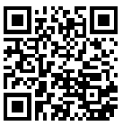
Please complete the CTE survey @ https://tinyurl.com/Grangerctesurvey24 The code is Z51EZ1

Slide 10
Show the counselor you have finished the survey and get a cool mindfulness calming strip.

Slide 11
What are you looking forward to as this school year ends and summer begins?

Slide 12
And remember, your Granger Family Loves You! We will see you back here on August 12th!

