Slide 1
Welcome to Class Selection for Juniors
Class of 2026

Slide 2
You’re about to be a Junior!

Slide 3
We have a few tasks for you today
Look at the credits you need for graduation
Select your classes for next year
Input your classes into the computer

Slide 4
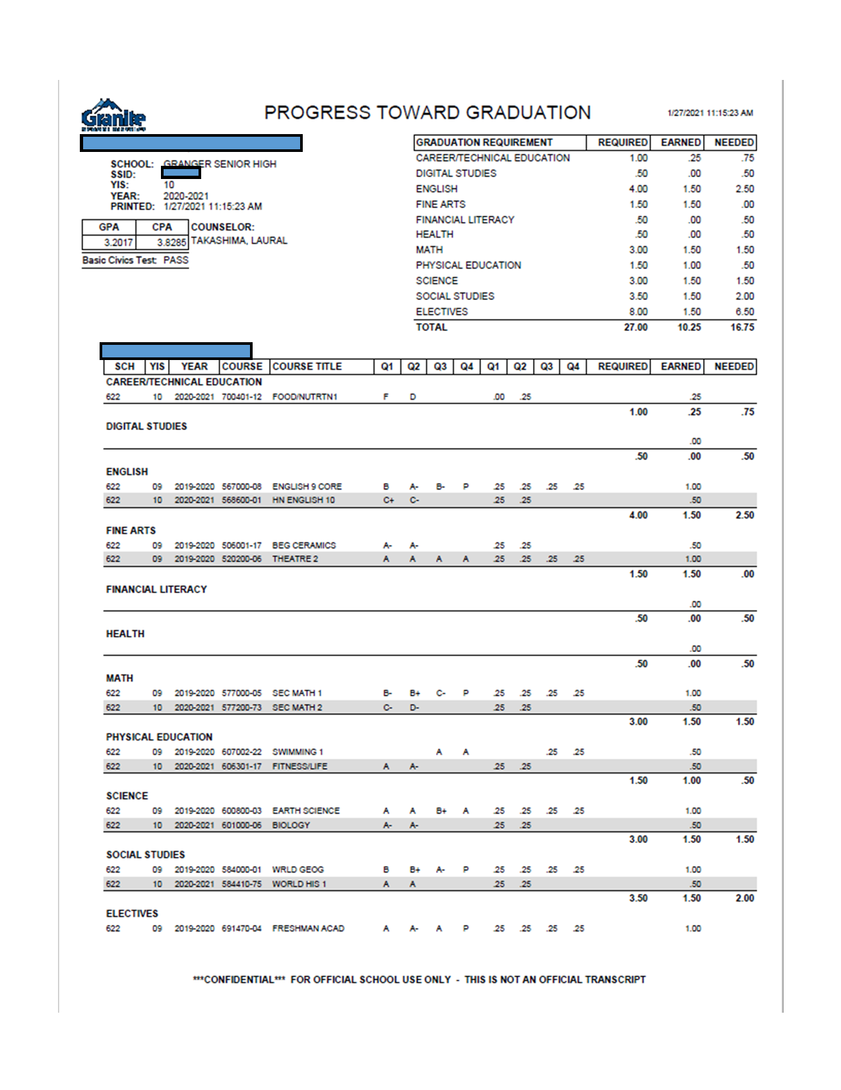
Graduation Requirements - Look at your PTG

Slide 5
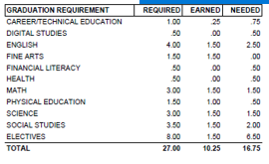
Graduation Requirments -
You should have between 10.5 credits (if you’re a seminary student) and 12 credits

Slide 6
CPA needs to be at least a 2.0 if you want to walk at graduation. GO TO CLASS!

Slide 7
You are the graduating class of 2026!
There are many things available to help you be successful your Junior year:
Junior year is crucial when preparing for college: Start looking up scholarships, visiting college and their websites, and saving money for college application fees and tuition
Start preparing for college by taking classes that will get you college credits or that explore your interests
You will have a College and Career Readiness Plan (CCRP) with your counselor
Go to College Day 2nd semester
You will take the ACT this year. Make sure you prepare for it.
This is the time to bring up your GPA and CPA. Do your best!

Slide 8
Some things to keep in mind when choosing classes:
Choose classes that connect to your interests
* What are you interested in taking?
* What do you want to do after high school?
Connect to your abilities
* What are you good at doing?
* What skills do you want to refine?
ALL YOUR CREDITS COUNT - SO PLAN ON PASSING ALL CLASSES
DO NOT:
* Choose classes your squad want you to take with them.
* Take classes with your boyfriend or girlfriend (because it's SUPER awkward when you break-up)
* Sign up for TA or Home Release or Sports Teams or Audition Classes (make sure you sign up for a full schedule!!!!!)

Slide 9
You can take classes to help get ahead:
Honors - rigorous classes that prepare you for college
Concurrent Enrollment (CE) - Receive high school and college credit at the same time. You can save money but you need to qualify with an ACT
Advanced Placement (AP) - college level classes and you can receive college credit if you pass the AP test at the end of the year
AP Classes are best paired with AP Independent Study.

Slide 10
Concurrent Enrollment saves you money
Concurrent Enrollment
College | Application (One Time) | Tuition for 3 Credits | Total Cost
GHS | $40 | $15.00 | $55.00
SLCC | $40 | $687.50 | $727.50
U of U | $55 | $1,941.82 | $1,996.82
BYU | $35 | $993 | $1,028

Slide 11
Keep in mind:
Taking honors, concurrent, and AP classes are a commitment. Signing up for an AP Class requires at least a semester commitment.

Slide 12
AP Expectations:
• AP independent study class
• Read at home and in class
• Work in class/Come to class prepared
• Communicate with the AP teacher
• Manage time wisely

Slide 13
AP Classes Available to Juniors
AP English Lit
AP English Language
AP American Government
AP Biology
AP Chemistry
AP Spanish
AP Spanish Lit.
AP Stats
AP Calculus AB
AP Calculus BC
AP Physics C (must be taken with AP Calc)
AP Music Theory
AP Drawing 2D
AP Ceramics
AP Art History
AP Psychology
AP World History
AP US History
AP Geography
AP Independent Study (to have time to study for your AP classes

Slide 14
Other Important Classes for Juniors
ACT Prep - You can take a class 1st semester for ACT Prep.
Foreign Language Check with the university you plan to attend to see if they require or if you plan to attend college out of state, you may need at least 2 years of a foreign language.
Start at level 3 or 4 if you are a native language speaker or consider AP Spanish

Slide 15
Granite Technical Institute (GTI)
* Hands on classes taken off campus (you take a bus there...it's like a field trip!)
* YOU NEED TO FILL OUT A PERMISSION SLIP TO TAKE THESE CLASSES & IT'S ON A FIRST TURNED IN, FIRST IN CLASS BASIS
*Put GTI in the alternates section of your class selection card and we will let you know if you made it in the class
*Get your permission slip SIGNED to your counselor or Mrs. Petty in the Career Center ASAP. You can also fill it out at Grangercounselingcenter.com and email it to your counselor

Slide 16
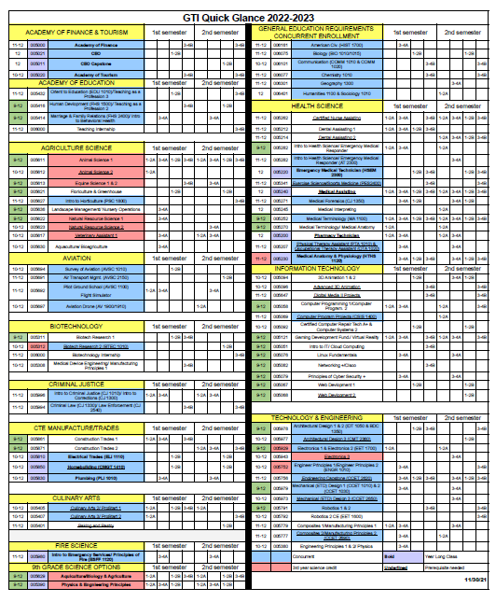
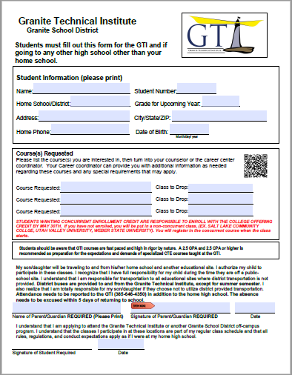

Slide 17
Learn more about GTI by watching this video

Slide 18
Now go to grangercounselingcenter.com
Go to class selection
2024-2025

Slide 19
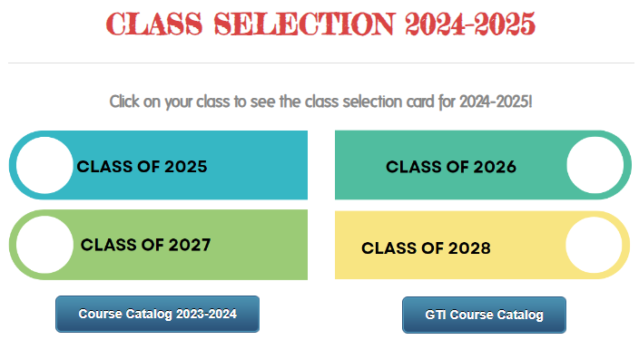
Now go to Class of 2026
On this page you can click the course catalog and see what each class is about
You can also look at fliers for each class at Granger and see what teachers have to advertise about each class
Make sure you click on CLASS OF 2026
You will fill out your class selection there.

Slide 20
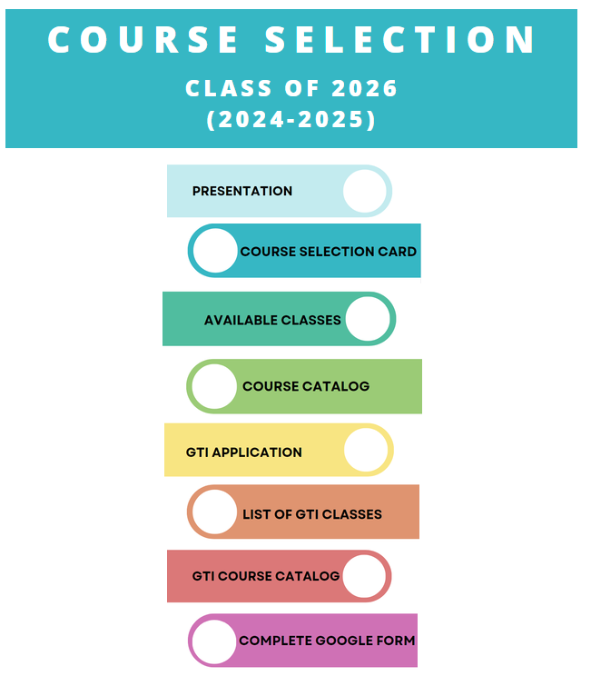
Junior Class of 2026
Here you will find this presentation
You will find the GTI application
YOU WILL PICK YOUR CLASSES FOR 11th GRADE

Slide 21
CLICK HERE TO PICK YOUR CLASSES FOR 11th GRADE
This is where you will choose your classes for next year.
Make sure you are taking classes you need for graduation
Make sure you choose alternate classes.

Slide 22
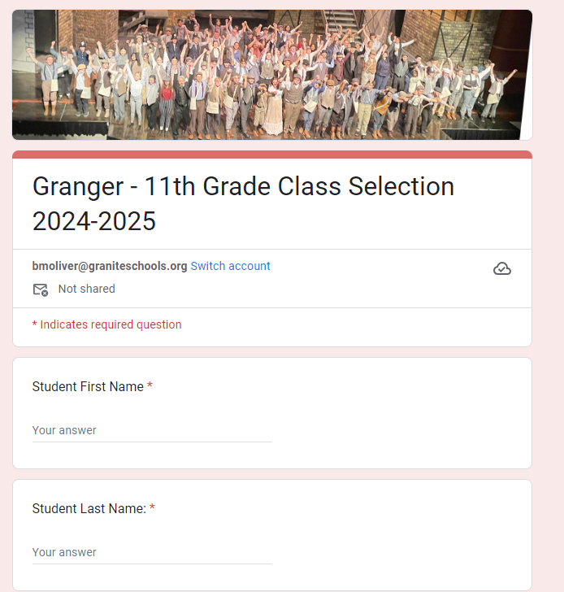
Now it’s time to fill out your card!
Make sure you fill out your first name, last name, and student number.
Keep in mind the class change policy.
Remember AP classes are a semester commitment
AND CHOOSE 16 BOXES FOR A FULL SCHEDULE

Slide 23
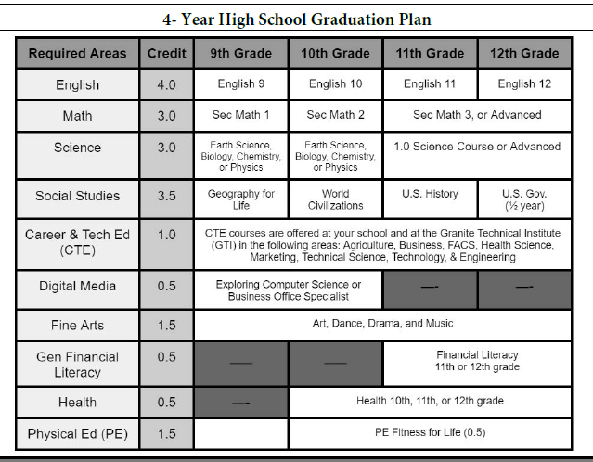
Look at your PTG
Make sure you are taking the classes you need for graduation.

Slide 24
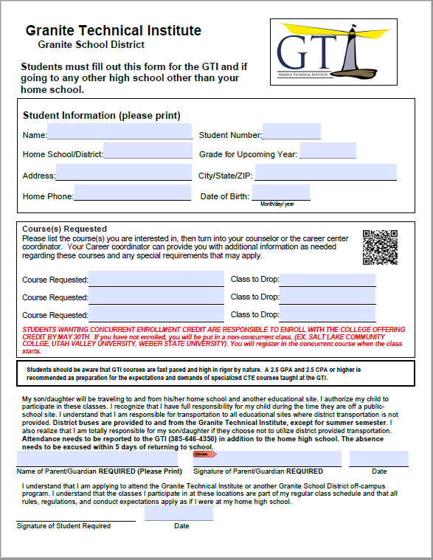
Add desired GTI classes here
Remember you must turn in a GTI application to take GTI classes!

Slide 25
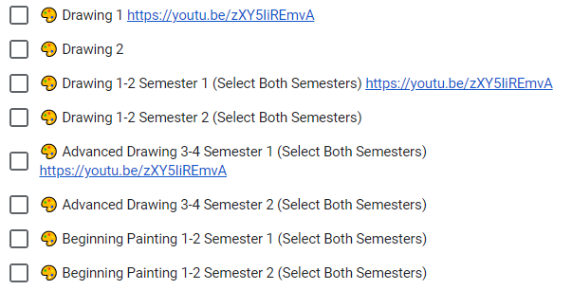
Don’t forget! Choose 16 boxes for a full schedule
S = Semester Class will be one box
Y= Year Class will indicate you need to choose two boxes and say (Select Both Semesters)
Choose your classes wisely.

Slide 26
How many boxes do you need?

Slide 27
16

Slide 28
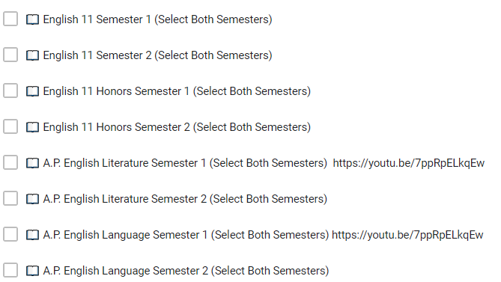
Let’s choose an English class
You need a year of Junior English and you have some choices:
English 11
English 11 Honors
AP English Literature (remember this requires a commitment)
AP English Language(remember this requires a commitment)
Choose two boxes of the same class.

Slide 29
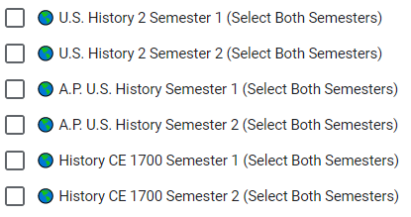
Let’s choose a Social Studies class
You need a year of US History for graduation. You can choose:
US History
AP US History (remember this requires a commitment)
Or History 1700 (remember this requires a commitment)
Choose two boxes of the same class.

Slide 30
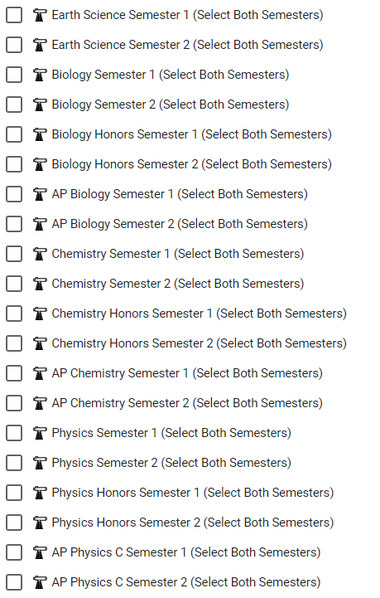
Let’s choose a science class.
Take a science you haven’t taken before. You need a full year.
Take science because it will make you more prepared for college
Take AP or CE science because it could help with the Opportunity Scholarship and better prepare you for college
Choose two boxes of the same class.

Slide 31
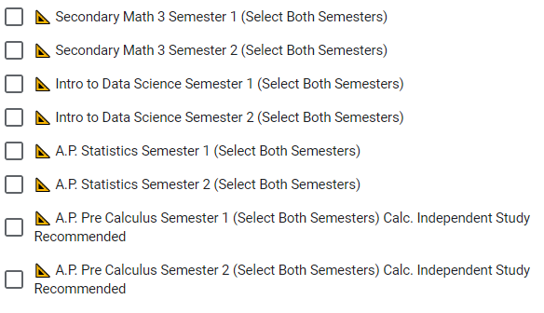
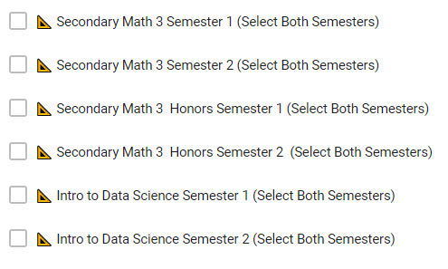
Let’s choose a math class
Choose a math class
Secondary Math 3
Intro to Data Science
AP Pre Calculus
Take math because it will make you more prepared for college
Choose two boxes of the same class.

Slide 32
You need to take Financial Lit
Financial Literacy is required for graduation. Get it over with and take it as a junior.

Slide 33
Take ACT Prep
ACT Prep will prepare you to take the ACT during your junior year. Learn tips and tricks to do better on the ACT and learn how to ace practice tests to get your best score. It is only offered 1st semester.

Slide 34
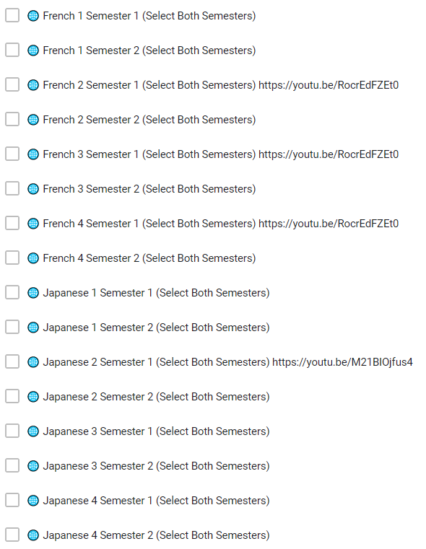
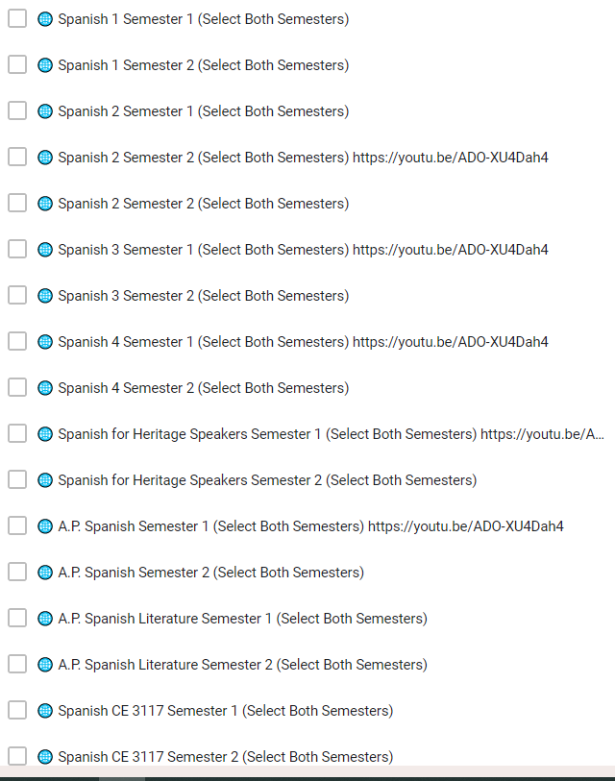
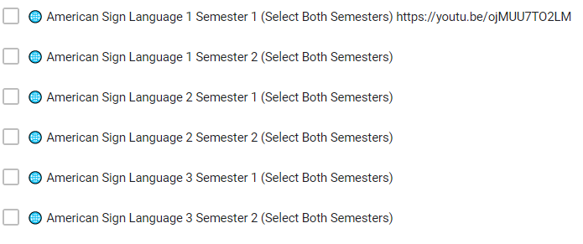
Take or continue with a Foreign Language
Foreign Language is a good idea for college.
You can also continue with a language you have taken previously
Two years of the same foreign language better prepares you for college

Slide 35
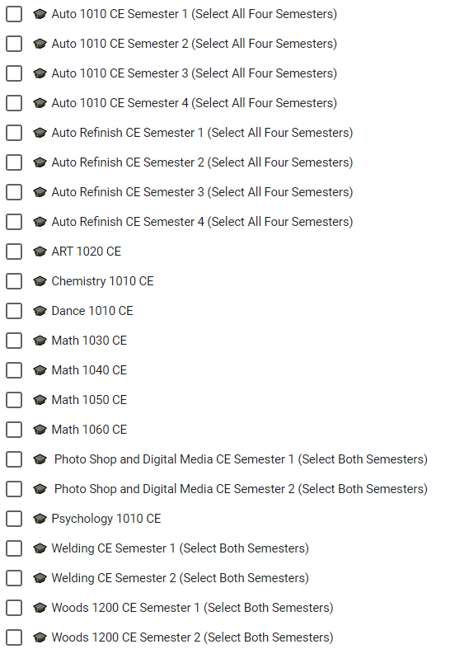
Consider Concurrent Enrollment
Concurrent enrollment earns you credit for both high school and college.
Keep in mind that concurrent enrollment can affect your college transcript so make sure you are committed to those classes
You will need to register for the college to take the class (about a $40 fee) and then pay a fee for credits (between $15 and $25)

Slide 36
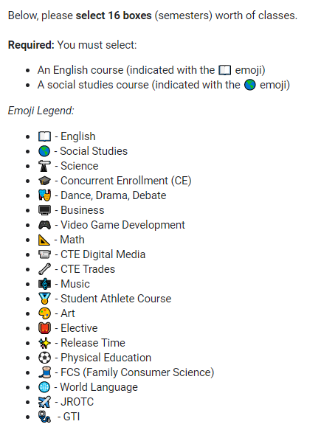
Now go ahead and choose your classes
Make sure you choose sixteen boxes.
Make sure you are taking classes to graduate.
Make sure you are taking classes to help you prepare for life after high school.
Challenge yourself! Get college and career preparedness.
Make the most of your junior year!

Slide 37
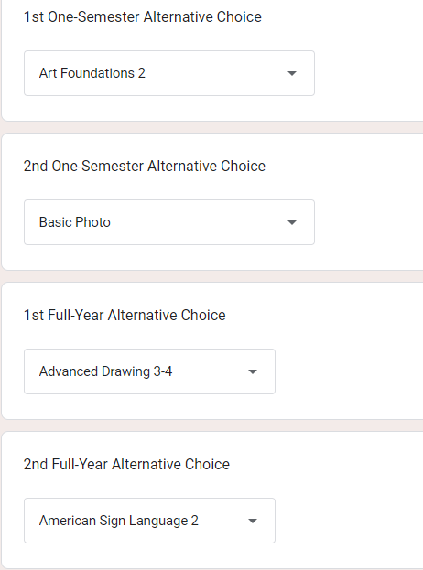
Don’t Forget!
Make sure you choose alternates in classes get cancelled or are full. Choose classes you haven’t taken before or have chosen today

Slide 38
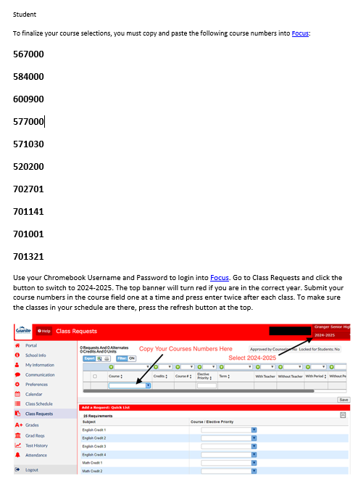
Now CHECK YOUR EMAIL
You will receive an email of the classes you chose
YOU’RE NOT DONE YET!
After you get the email you will need to log into FOCUS and enter your choices there!

Slide 39
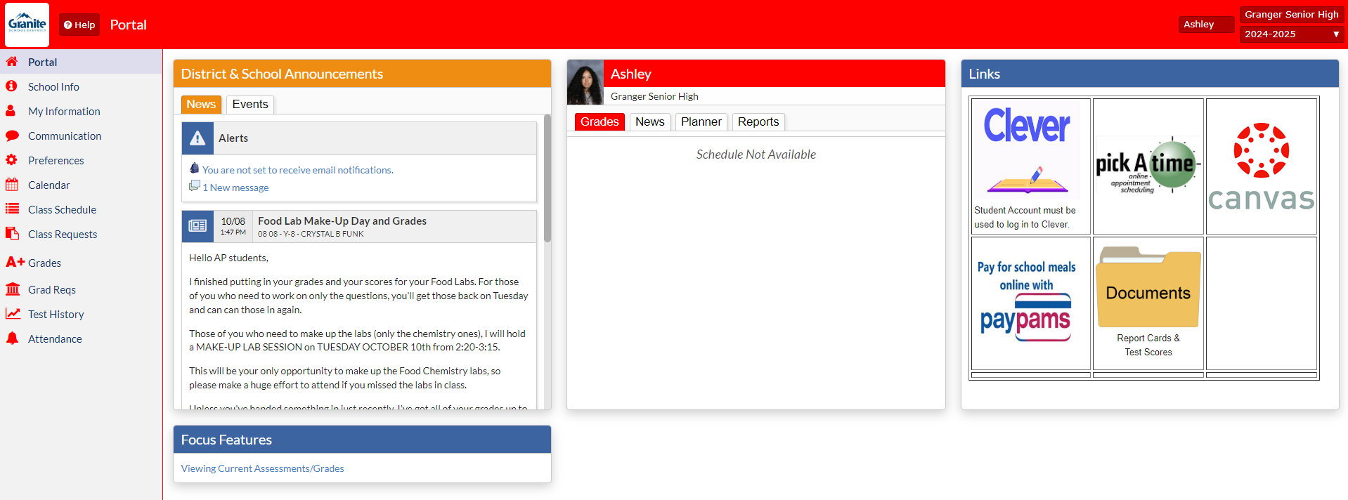
Now go to FOCUS and log in and go to class requests

Slide 40
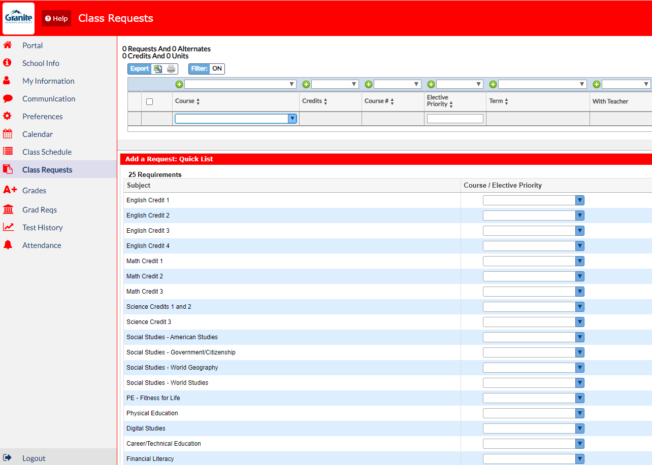
This is where you will add the numbers from your email

Slide 41
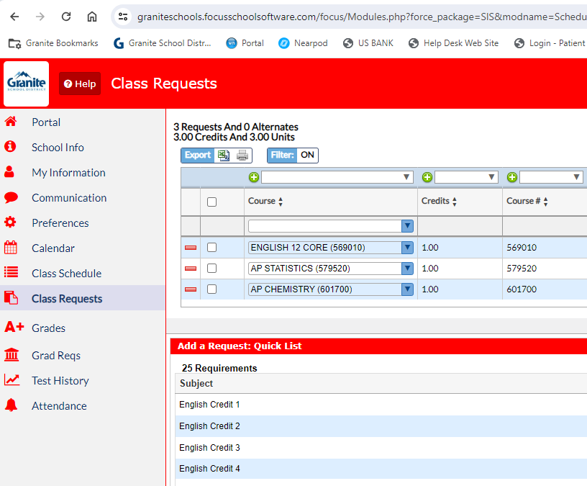
Enter the numbers for all classes you chose
Once you have entered the number press enter twice
Press reload to make sure the class is in your schedule
Once you have 8 credits that’s it! You have put in all your classes

Slide 42
8 Credits? Good Job!

Slide 43
Now enter your alternates -

Slide 44
You can do it one of two ways
You can enter it where it says course number and then indicate preference with
2 as your first choice for alternates
3 as your second choice for alternates
4 as your third choice for alternates
5 as your fourth choice for alternates
OR you can put in under electives –
- make sure you hit save

Slide 45
Let’s Review
*Make sure your name and student number and current information are on your card
*You've filled 16 boxes which include:
* English (2 boxes)
* US History (2 boxes)
* Secondary Math 3 (2 boxes)
* Science (2 boxes)
* Financial Literacy (1 box)
* You have 4 alternates filled out in case classes are full or canceled
* You are taking classes that prepare you for college, a job and/or the Opportunity Scholarship
* Make sure you get your GTI application in ASAP

Slide 46
Once you have your choices make sure you submit
Check that you have 16 boxes.
Check your granitesd account. You should receive an email of your class choices once you have submitted
You can change them until March 1

Slide 47
Contact your counselor or the counseling center if you have any questions or concerns.
385-646-5321

