Slide 1
The Pathway to Graduation
Class of 2024

Slide 2
Step One
Fill out your Graduation Application
All students this year are required to complete a graduation application to receive a diploma and cap & gown. Pick up your application on Wednesday, May 1st in the commons during lunches. Tell your friends.

Slide 3
This is the graduation application

Slide 4
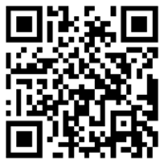
You must fill out this survey to graduate. Fill it out now!
Go to Grangercounselingcenter.com to fill out the survey or scan this QR Code:

Slide 5
Don’t Forget CPA
To walk across the stage at The Maverik Center on Friday, May 24, 2024 at 7:00 pm, you must make up the CPA hours you need to finish. See Mr. Jackson or Mr. Bernard for opportunities to make up your CPA. You need a 2.0 in CPA to walk across the stage.

Slide 6
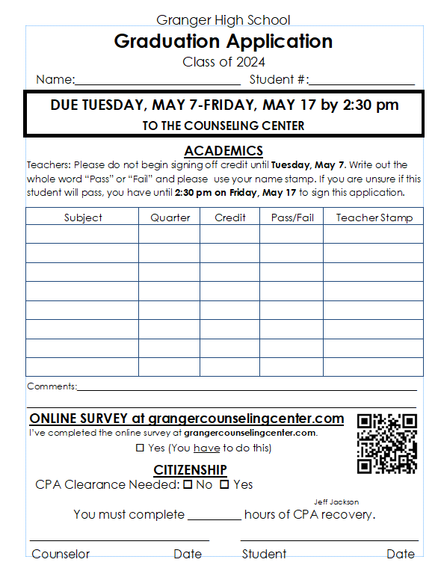
Graduation Applications are due beginning Tuesday, May 7th to your counselor in the Counseling Center

Slide 7
Make Sure You PAY YOUR FEES
Check with the finance office and find out how much you owe AS SOON AS POSSIBLE.
Start making a plan to pay your fees.
You need to pay your fees to pick up your cap and gown.

Slide 8
Once you have submitted your application, you have to getting the following signatures

Slide 9
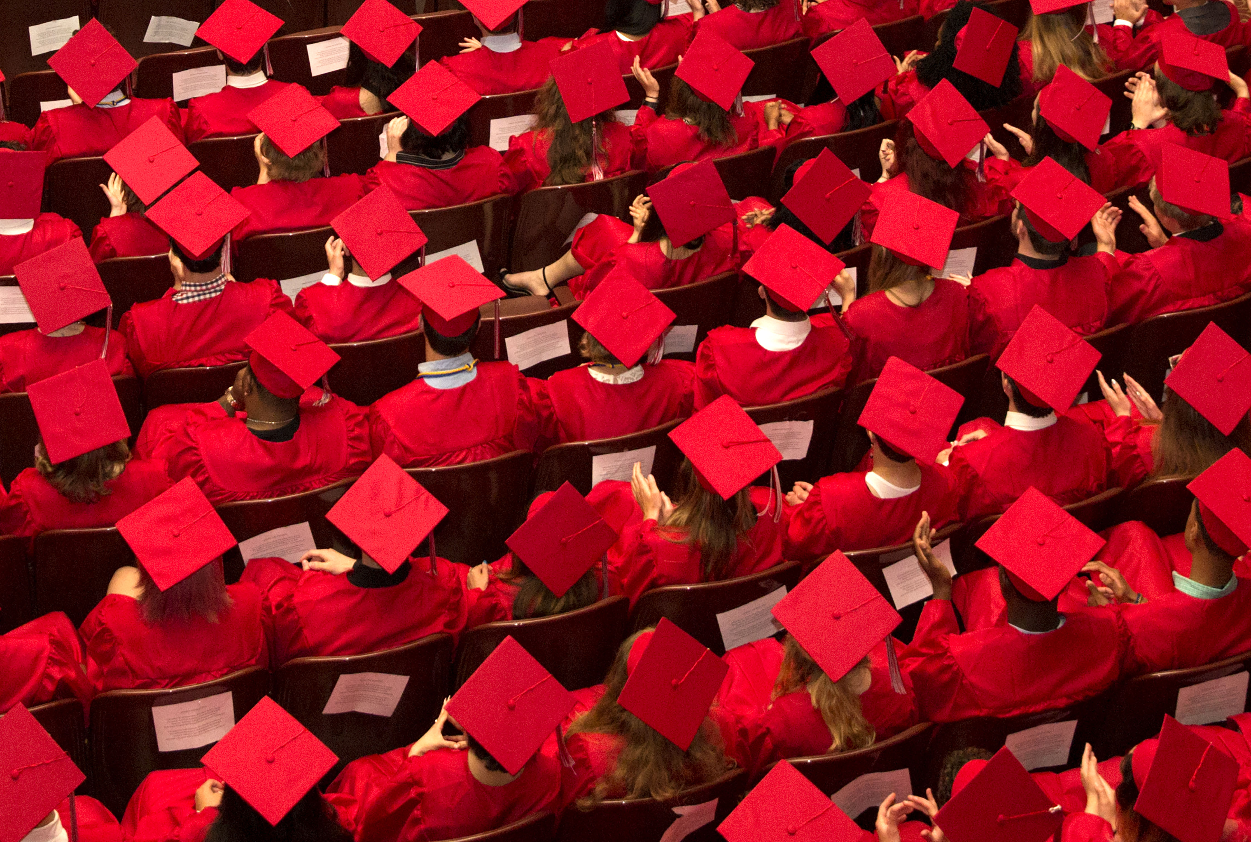
Caps and Gowns May 8th
Caps and Gowns will be passed out Wednesday, May 8th during lunches. You must be cleared with your grades, CPA, fees & fines, library fees, and school lunch to pick up your cap and gown. Pick up a cleared card from your counselor when you turn in your graduation application.

Slide 10
Don’t Fail Classes This Quarter
Keep in mind that you can't make-up classes you fail this quarter with a packet. You must pass all the classes you need for graduation this quarter.

Slide 11
Step Two
Go to college this fall or have a plan for what you will do after you graduate.

Slide 12
You need to have a plan!
Applications are not difficult, if you need help filling out an application, you can meet with your counselor or the College Advisor, Kris Jones, in the Career Center to do this. Please do this ASAP

Slide 13
Going to College is an Investment in You
While the prospect of attending college may seem expensive, it is important to realize how much those four years will pay off later.

Slide 14
It pays to be educated

Slide 16
Step 3
Apply for FAFSA today!
FAFSA- Free Application for Federal Student Aidfafsa.ed.gov
Qualify for grants (FREE money)!
All you need is: Social Security Number, Parents' taxes from last year (2022 )If you do not have these, please see a counselor to discuss financial options.
THERE ARE ALWAYS OPTIONS! YOU JUST HAVE TO ASK!

Slide 17
You need to make a plan and start somewhere

Slide 18
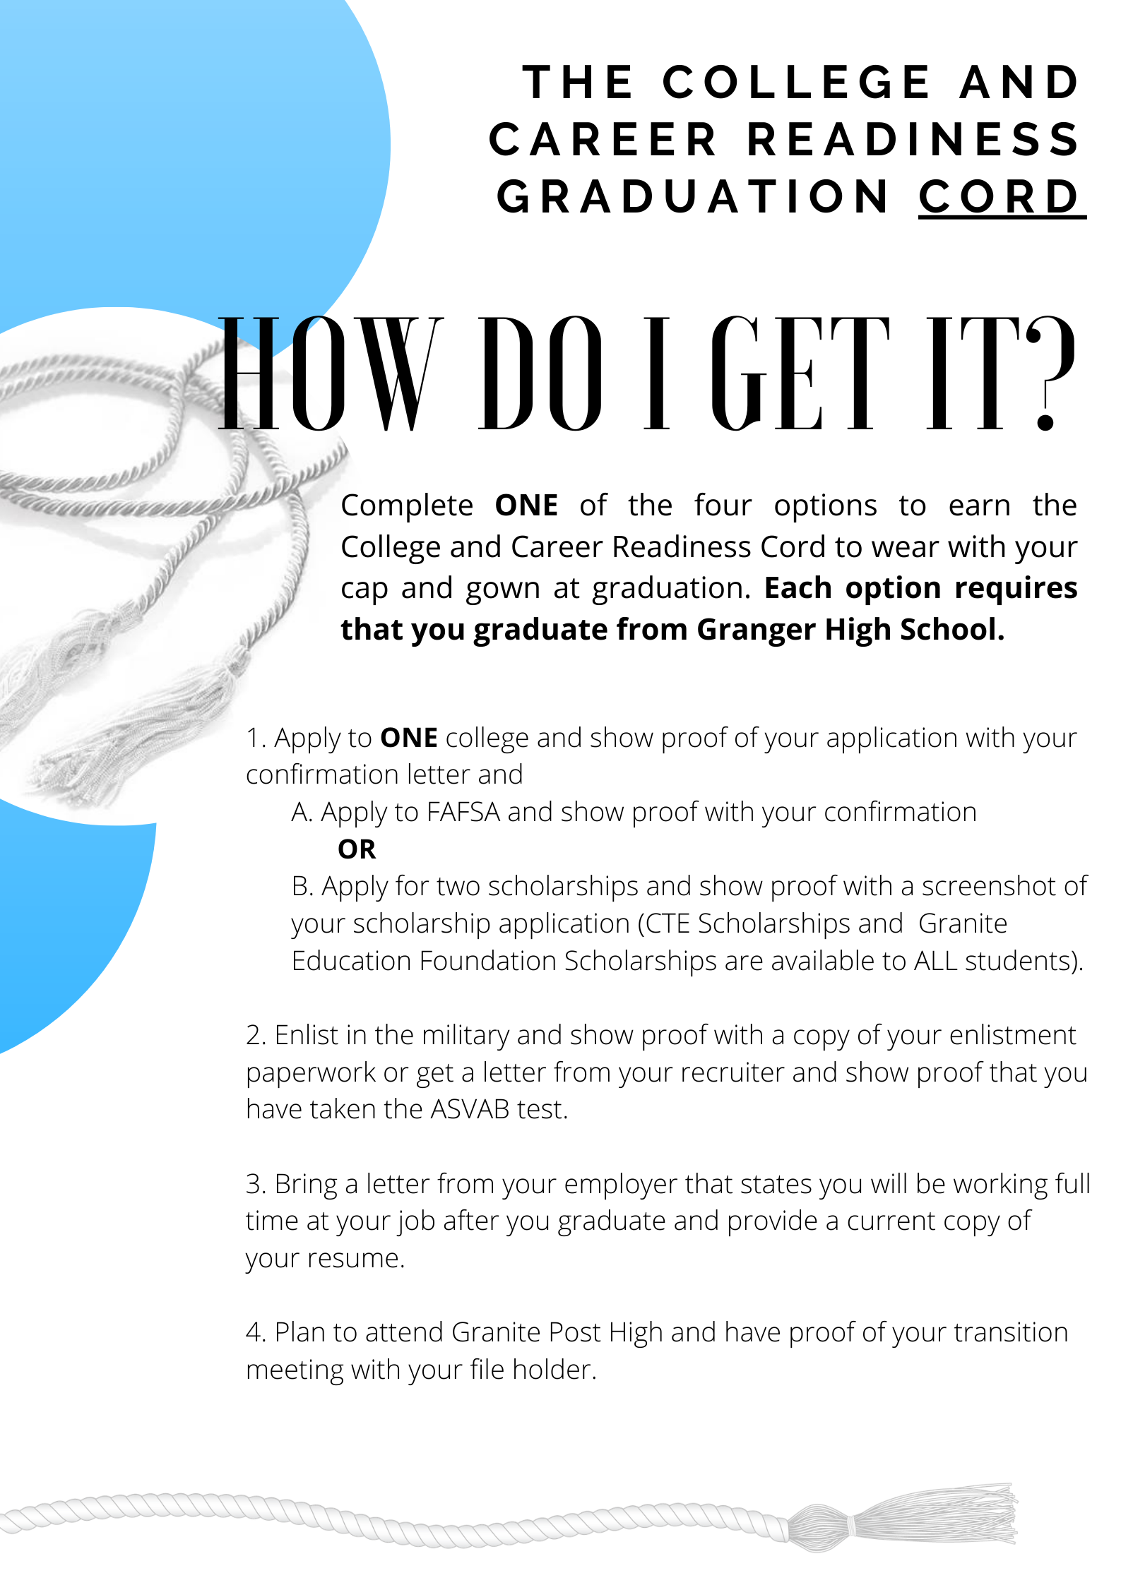
Apply for the College and Career Readiness Cord

Slide 19
Apply for the College and Career Readiness Cord at: https://tinyurl.com/CCRGRADCORD

Slide 20
Earn the CTE Completer Cord
1. Obtain a copy of your PTG from your counselor.
2. Highlight the CTE classes required for your CTE pathway. There are over 30 pathways to choose from.
3. Take a photo of your highlighted PTG form and upload to your application. 4. Fill out this application. (You will need to fill out a new application if you have earned an additional Pathway) 5. A completer cord is awarded to a student who has competed 3.0 credit or 6 semesters of classes in a specific CTE Pathway. 4. A concentrator certificate is awarded to a student who has completed a concentrator class in a CTE Pathway. 5. If you have any questions please see Mr. Platero in the Career Center A-125 or email him at mplatero@graniteschools.org
https://tinyurl.com/CTECord23

Slide 21
Apply for the CTE Completer Cord at: https://tinyurl.com/CTECord24

Slide 22
Step Four – You need to save your documents
Make sure that you get a new email if you have not already. Your granitesd.org email will disappear as of Friday, May 24th. You will also lose all your documents in your Google account. Make sure you have saved them on a flash drive, on your home computer, or in a newly made Google account.

Slide 23
You must go to graduation practice
Graduation Practice is Thursday, May 23rd at 7:30 am in Granger High School’s Auditorium. You must go to Graduation Practice to participate at graduation.

Slide 24
Senior Dates to know

Slide 25
Congratulations Class of 2024! We are so proud of you!

