Slide 1
You’re a sophomore!
Class of 2020
You made your way through 9th grade, and now you're probably wondering what to expect your sophomore year in high school.

Slide 2
Common terms/vocabulary
PTG: Progress Toward Graduation
GPA: Grade Point Average
CPA: Citizenship Average
CCRP: College Career Readiness Plan
AP: Advance Placement
CTE: Career Technical Education
GTI: Granite Technical Institute

Slide 4
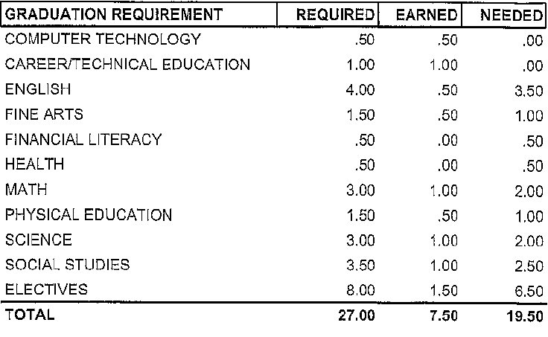

Slide 5
Review of PTG How many credits has this student earned? Did this student pass their civics test? Does this student need credit recovery packets?

Slide 6
Credit Recovery & On track
Types: Location: Price
In Class (2.0 GPA) Room E203 $10 per packet
After School
What does it mean to be “on track?”
You have passed all of your core classes from freshman year.
Core classes are English, Math, Science and Social Studies.
You should have 8 - 7 credits
If you have less than 7 credits see your counselor.

Slide 7
Honors, AP, Online, GTI
Honors: more challenging classes with increased amounts of coursework.
AP: Advanced Placement (test taken at the end of course for college credit)
Online classes: taken through Connections High School, see your counselor for the form.
GTI: Granite Technical Institute
Provides career &technical career pathways
Hands on experiences
Certifications & licenses

Slide 8
PSAT
The Preliminary Scholastic Aptitude Test
Practice college entrance exam
Offers feedback on academic skills
Wednesday, October 11th
Cost: $10
See Mrs. Takashima if you have any questions.

Slide 10
Most require a tryout
GPA: 2.0
No more than 2 failing grades
Visit our school website for:
Coach & advisor info
Tryout dates
Meeting locations
Game & practice schedules
Fees

Slide 11
resources
Website: grangercounselingcenter.com
Social Worker: Kim Sommers
Nurse: Jamie Ferdinand, room E205
Food Pantry
Parent Center
SafeUT App

