Slide 1
Welcome to Class Selection for Sophomores
Class of 2027

Slide 2
You’re about to be a Sophomore!

Slide 4
We have a few tasks for you today
Look at the credits you need for graduation
Select your classes for next year
Input your classes into the computer

Slide 5
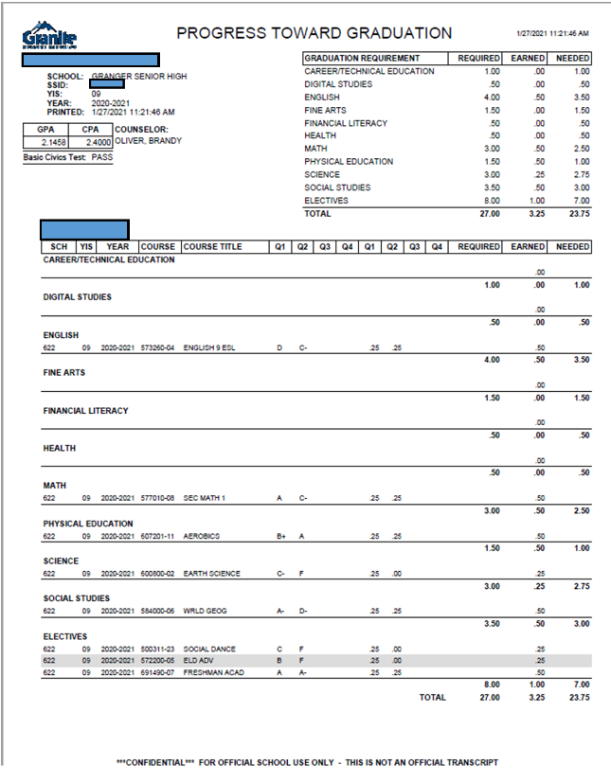
Graduation Requirements

Slide 6
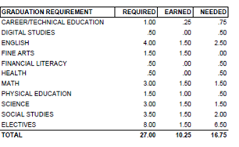
Graduation Requirments -
You should have between 3.5 credits (if you’re a seminary student) and 4.0 credits

Slide 7
CPA needs to be at least a 3.0 if you want to walk at graduation. GO TO CLASS!

Slide 8
You are the graduating class of 2027!
There are many things available to help you be successful this year:
You will have a College and Career Readiness Plan (CCRP) with your counselor every year
Everyone wants to take Drivers Ed. You need to have your driver’s permit.
1st Semester - You need to be 16 by 2-1-25
2nd semester You need to be 16 by 7-15-25
Drivers Ed costs $185 and needs to be paid by the 2nd week of class.
Summer Drivers Ed is available to students who will be 16 by October 30, 2024.
Summer Drivers Ed costs $185 and you must sign up in the Finance Office and
YOU MUST HAVE YOUR PERMIT BEFORE YOU START THE CLASS

Slide 9
Some things to keep in mind when choosing classes:
Choose classes that connect to your interests
* What are you interested in taking?
* What do you want to do after high school?
Connect to your abilities
* What are you good at doing?
* What skills do you want to refine?
ALL YOUR CREDITS COUNT - SO PLAN ON PASSING ALL CLASSES
DO NOT:
* Choose classes your squad want you to take with them.
* Take classes with your boyfriend or girlfriend (because it's SUPER awkward when you break-up)
* Sign up for TA or Home Release or Sports Teams or Audition Classes (make sure you sign up for a full schedule!!!!!)

Slide 10
You can take classes to help you get ahead:
Honors - rigorous classes that prepare you for college
Concurrent Enrollment (CE) - Receive high school and college credit at the same time. You can save money but you need to qualify with an ACT
Advanced Placement (AP) - college level classes and you can receive college credit if you pass the AP test at the end of the year

Slide 11
Concurrent Enrollment saves you money
Concurrent Enrollment
College | Application (One Time) | Tuition for 3 Credits | Total Cost
GHS | $40 | $15.00 | $55.00
SLCC | $40 | $687.50 | $727.50
U of U | $55 | $1,941.82 | $1,996.82
BYU | $35 | $993 | $1,028

Slide 12
Keep in mind:
Taking honors, concurrent, and AP classes are a commitment. Signing up for an AP Class requires at least a semester commitment.

Slide 13
AP Expectations:
• AP independent study class
• Read at home and in class
• Work in class/Come to class prepared
• Communicate with the AP teacher
• Manage time wisely

Slide 14
Granite Technical Institute (GTI)
* Hands on classes taken off campus (you take a bus there...it's like a field trip!)
* YOU NEED TO FILL OUT A PERMISSION SLIP TO TAKE THESE CLASSES & IT'S ON A FIRST TURNED IN, FIRST IN CLASS BASIS
*Put GTI in the alternates section of your class selection card and we will let you know if you made it in the class
*Get your permission slip to your counselor or Mrs. Petty in the Career Center ASAP. You can also fill it out at Grangercounselingcenter.com and email it to your counselor

Slide 15
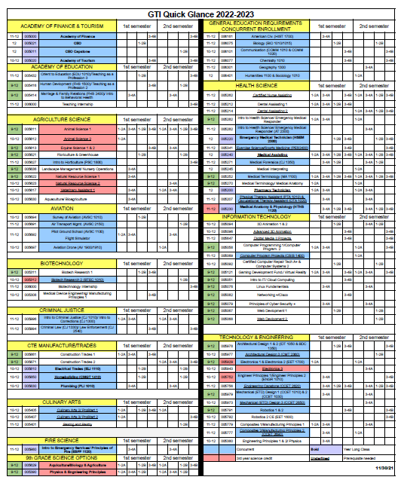
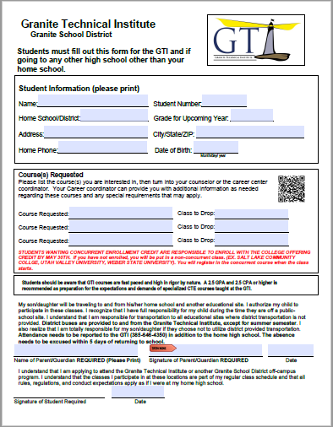

Slide 16
Learn more about GTI by watching this video

Slide 17
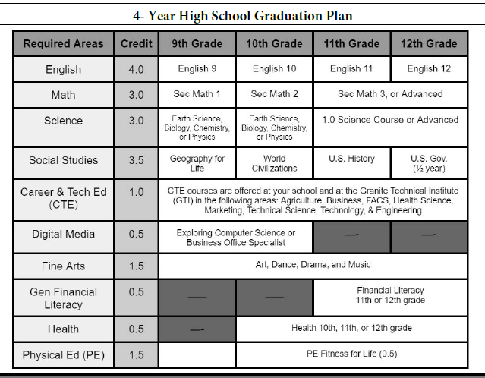
Look at your PTG
Make sure you are taking the classes you need for graduation.

Slide 18
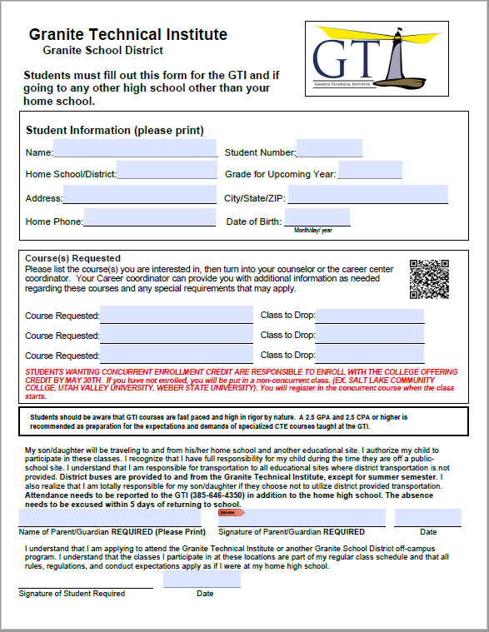
Add desired GTI classes here
Remember you must turn in a GTI application to take GTI classes!

Slide 19
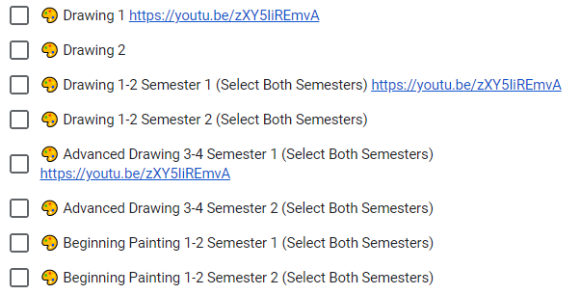
Don’t forget! Choose 16 boxes for a full schedule
S = Semester Class will be one box
Y= Year Class will indicate you need to choose two boxes and say (Select Both Semesters)
Choose your classes wisely.

Slide 20
Now go to grangercounselingcenter.com
Go to class selection
2024-2025

Slide 21
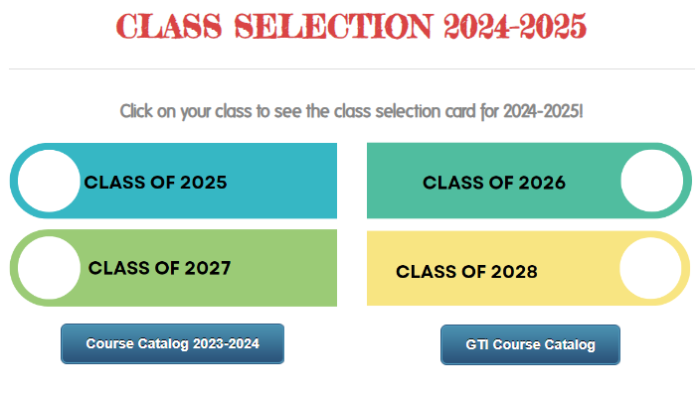
Now go to Class of 2027
On this page you can click the course catalog and see what each class is about
You can also look at fliers for each class at Granger and see what teachers have to advertise about each class
Make sure you click on CLASS OF 2027
You will fill out your class selection there.

Slide 22
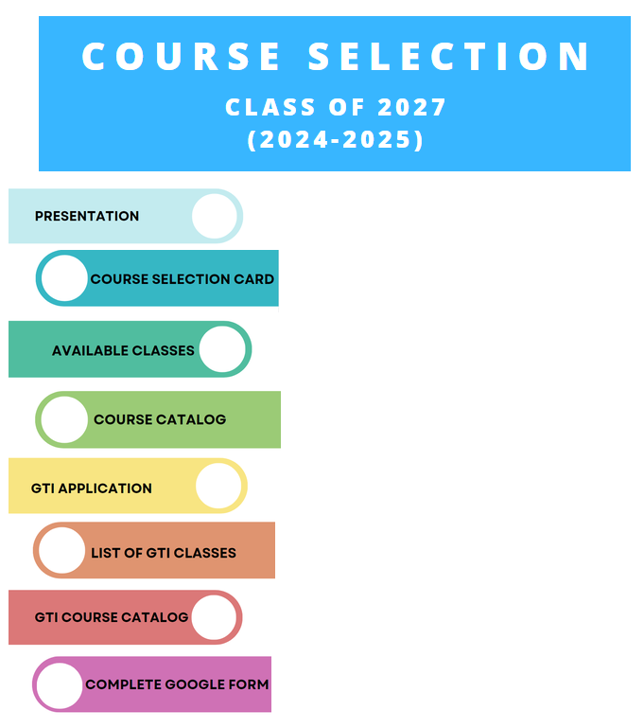
Sophomore Class of 2027
Here you will find this presentation
You will see a video about Granger
You will find the GTI application
YOU WILL PICK YOUR CLASSES FOR 10th GRADE

Slide 23
CLICK HERE TO PICK YOUR CLASSES FOR 10th GRADE
This is where you will choose your classes for next year.
Make sure you are taking classes you need for graduation
Make sure you choose alternate classes.

Slide 24
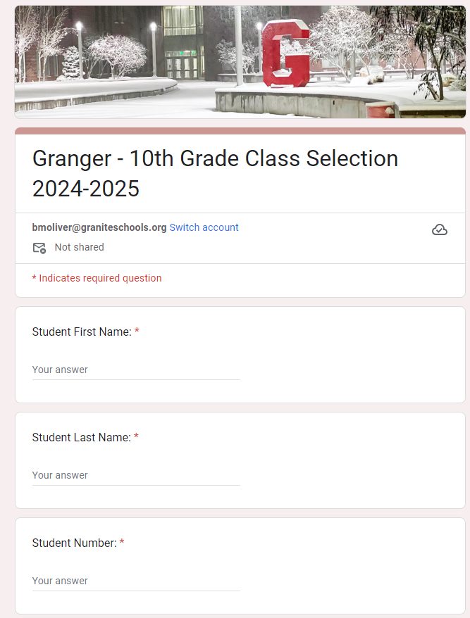
Now it’s time to fill out your card!
Make sure you fill out your name, phone number, and student number.
Keep in mind the class change policy.
Remember AP classes are a semester commitment
AND CHOOSE 16 BOXES FOR A FULL SCHEDULE

Slide 25
How many boxes do you need?

Slide 26
16

Slide 27
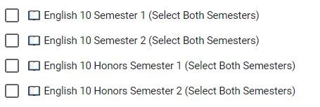
Let’s choose an English class
You need a year of Sophomore English and you have some choices:
English 10
English 10 Honors
Choose two boxes of the same class.

Slide 28
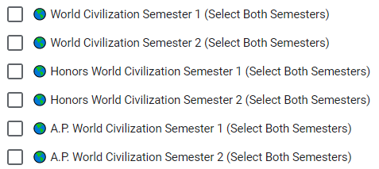
Let’s choose a History class
You need a year of World History for graduation. You can choose:
World Civilization
World Civilization Honors
AP World World Civilization
Choose two boxes of the same class.

Slide 29
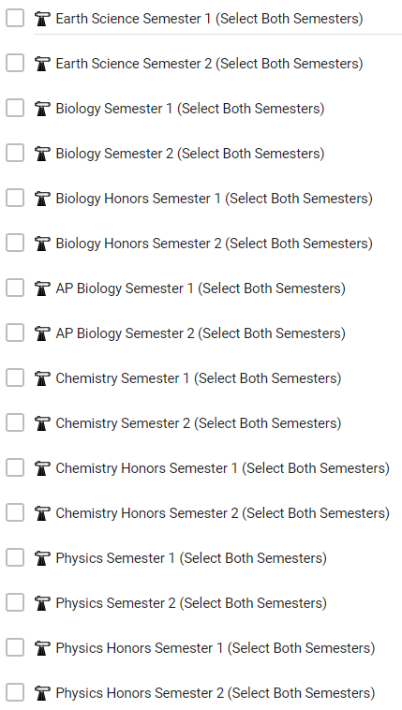
Let’s choose a science class.
Take a science you haven’t taken before. You need a full year.
Take science because it will make you more prepared for college
Choose two boxes of the same class.

Slide 30
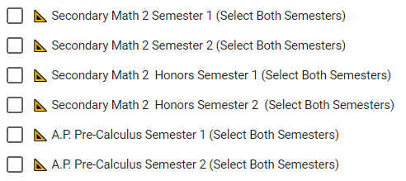
Let’s choose a math class
Choose a math class
Secondary Math 2
Secondary Math 2 Honors
AP Pre Calculus if you are currently in Math 2 Honors
Choose two boxes of the same class.

Slide 31
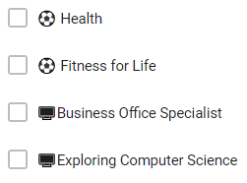
Three Classes You Should Consider Taking
Health is required for graduation and you should take it sometime in 9th or 10th. It is a half year
Fitness for Life is a required PE class for graduation. You need to take it during high school. It is advised to take it during 9th, 10th, or 11th. It’s a half year.
Business Office Specialist, Exploring Computer Science, or Web Development is your Digital Studies credit. You should take one during 9th or 10th. It’s a half year.

Slide 32
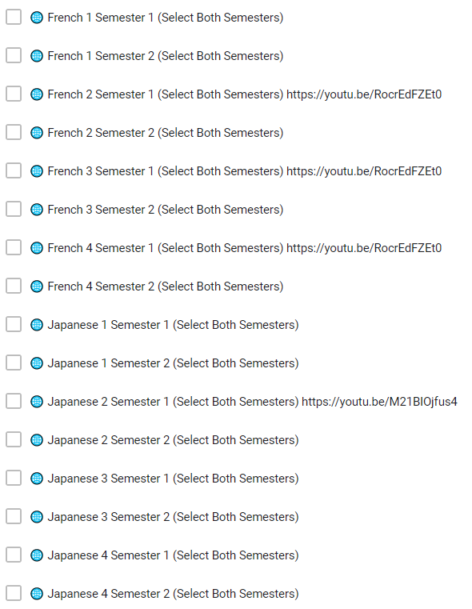
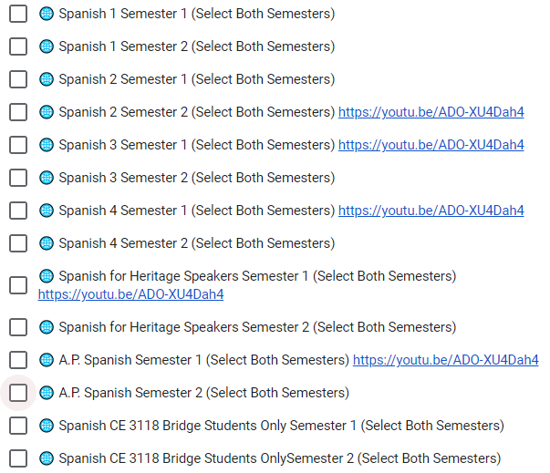
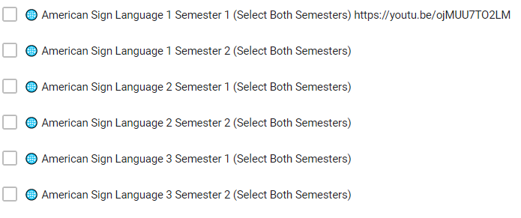
Take or continue with a Foreign Language
Foreign Language is a good idea for college.
You can also continue with a language you have taken previously
Two years of the same foreign language better prepares you for college

Slide 33
Drivers Education
You need to have your driver’s permit.
1st Semester - You need to be 16 by 2-1-25
2nd semester You need to be 16 by 7-15-25
Drivers Ed costs $185 and needs to be paid by the 2nd week of class.
Summer Drivers Ed is available to students who will be 16 by October 30, 2024.
Summer Drivers Ed costs $185 and you must sign up in the Finance Office
You must have your drivers permit prior to beginning Drivers Education

Slide 34
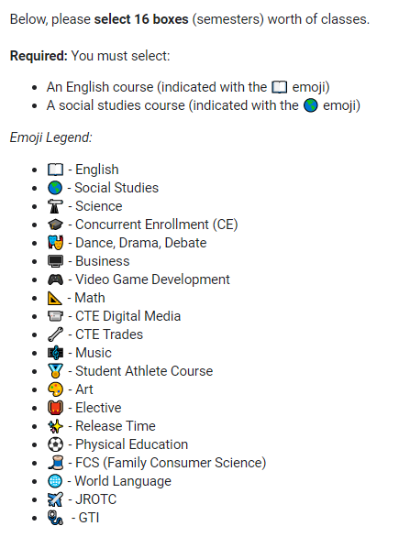
Now go ahead and choose your classes
Make sure you choose sixteen boxes.
Make sure you are taking classes to graduate.
Make sure you are taking classes to help you prepare for life after high school.
Challenge yourself! Get college and career preparedness.
Make the most of your sophomore year!

Slide 35
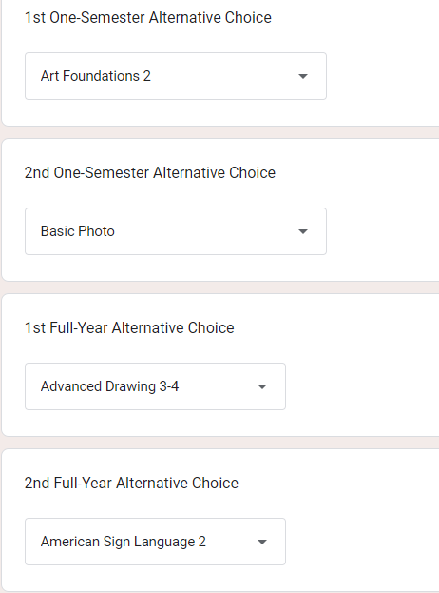
Don’t Forget!
Make sure you choose alternates in classes get cancelled or are full. Choose classes you haven’t taken before or have chosen today.

Slide 36
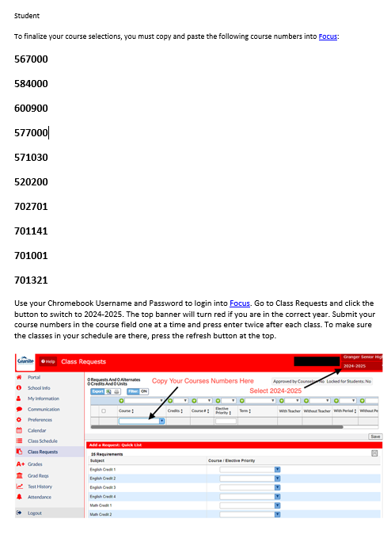
Now CHECK YOUR EMAIL
You will receive an email of the classes you chose
YOU’RE NOT DONE YET!
After you get the email you will need to log into FOCUS and enter your choices there!

Slide 37
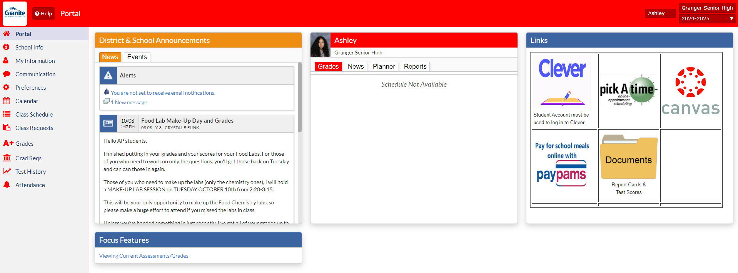
Now go to FOCUS and log in and go to class requests

Slide 38
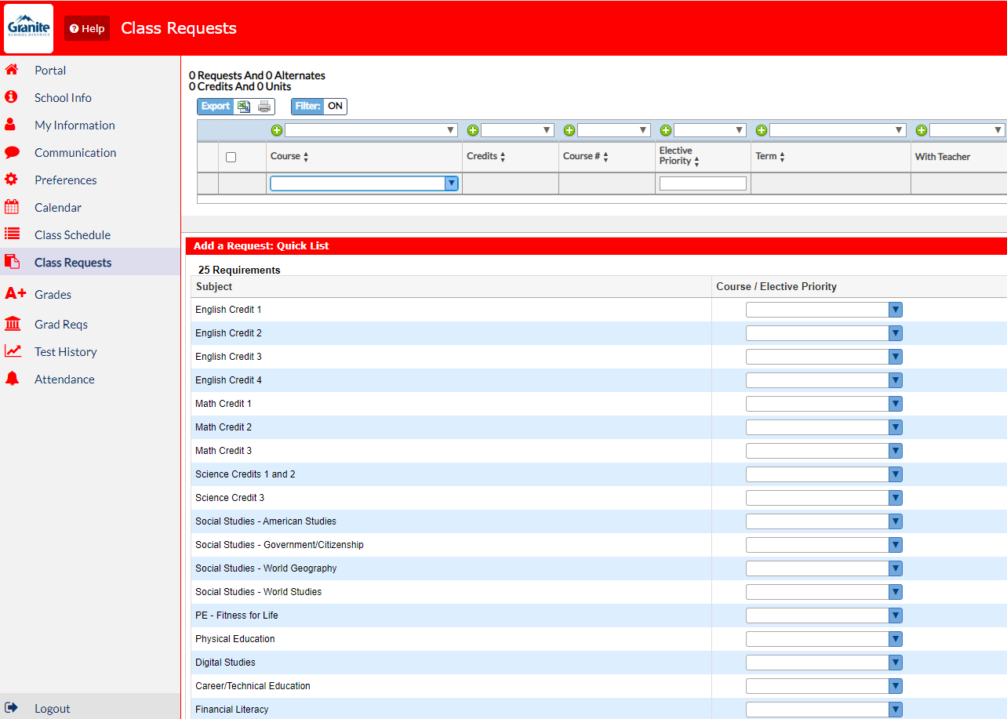
This is where you will add the numbers from your email

Slide 39
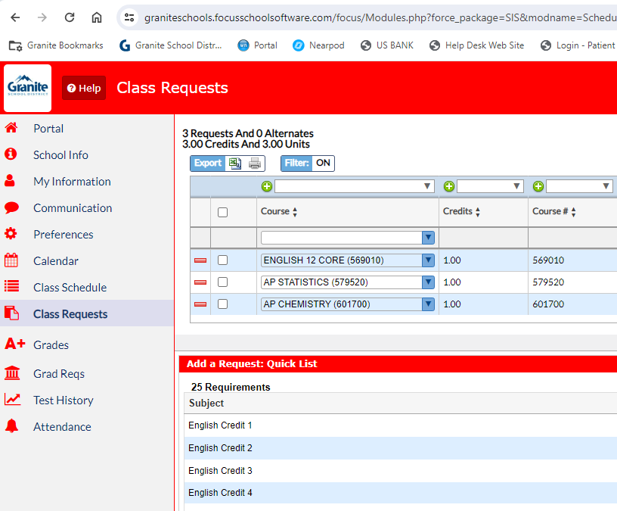
Enter the numbers for all classes you chose

Slide 40
8 Credits? Good Job!

Slide 41
Now enter your alternates -

Slide 42
You can do it one of two ways
You can enter it where it says course number and then indicate preference with
2 as your first choice for alternates
3 as your second choice for alternates
4 as your third choice for alternates
5 as your fourth choice for alternates
OR you can put in under electives –
- make sure you hit save

Slide 43
Let’s Review
*Make sure your name and student number and current information are on your card
*You've filled 16 boxes which include:
* English (2 boxes)
* World Civ (2 boxes)
* Secondary Math 2 (2 boxes)
* Science (2 boxes)
* Health, Digital Studies, and/or Fitness for Life
* You have 4 alternates filled out in case classes are full or canceled
*NO TA, HOME RELEASE, SPORTS, or TRYOUT CLASSES
* You are taking classes that prepare you for college, a job and/or the Opportunity Scholarship
* Make sure you get your GTI application in ASAP

Slide 44
Once you have your choices make sure you submit
Check that you have 16 boxes.
Check your google mail account. You should receive an email of your class choices once you have submitted
You can change them until March 1st

Slide 45
Contact your counselor or the counseling center if you have any questions or concerns.
385-646-5321

